Slide 1

TA kick-off / instruction slides
Basic suggestion slides for a 1 hour TA kick-off and instruction session
‘Cell’ images by Manfred Steger via Pixabay.com

Slide 2
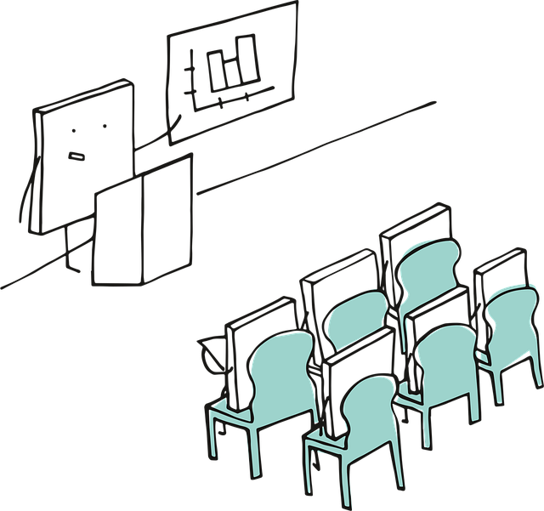
Structure for a clear and motivating TA instruction
Who? (~15 minutes)
Create team-spirit and an open communication structure: Everybody knows who is who, and who to reach for what. Use an icebreaker, an introductory round and for example let everyone share a bit about their vision/experience with teaching.
Why do you have a certain course design? (~5-10 minutes)
Validate the purpose or usefulness of the design: What does it bring students? (short / long term)
Why did you choose your design or the chosen workflows in particular? How does it fit your ILOs?
What are experiences or pitfalls from the previous design that you now tackle with active teaching?
What are we going to do? (~5-10 minutes)
Explain step by step what the course plan is, and in which parts the TAs play a role. Name your expectations of them. They will probably play a more active role than just answering questions. Use visual support where possible.
Check if it is clear (~5 -10 minutes)
Give room for questions and for possible concerns. If you like, let TAs give small tips or tweaks on your design. They are often most in contact with the students. If you use a very out-of-the box design, check if TAs feel comfortable, and ask what they need if not.
How are we going to do this? → Call to action, room for fine-tuning (~20 minutes)
Only now explain practical matters: How much time, which materials, which group division, possible lesson plans, schedules, slides, grading models, rubrics, etc.
Hand out your paperwork etc. at the end, because as soon as you do this you will lose attention. Or do it when you want TAs to use the paperwork actively during this meeting!
Notes:
This structure also works very well if you’ve not redesigned your course, but when you start with a new group of TAs, or actually any time you do a course with TAs. Getting everyone on board with your course goals and structure, and discussing expectations and tasks for the TA is a great way to start.

Slide 3
Template slides: Table of contents
Who: Team get-to-know and teaching vision
  Basic slide
  Example activities
Why: Are we doing this
  Basic suggestions slides for informative explanation
What: Is the course plan and teaching style
  Basic suggestion slides for informative explanation and small input
Check: Check and input/feedback
  Basic suggestion slides for discussing the TAs first response to the design
How: Are we going to do it; practicalities
  Basic slides for discussing and aligning details, practicalities and tasks

Slide 4
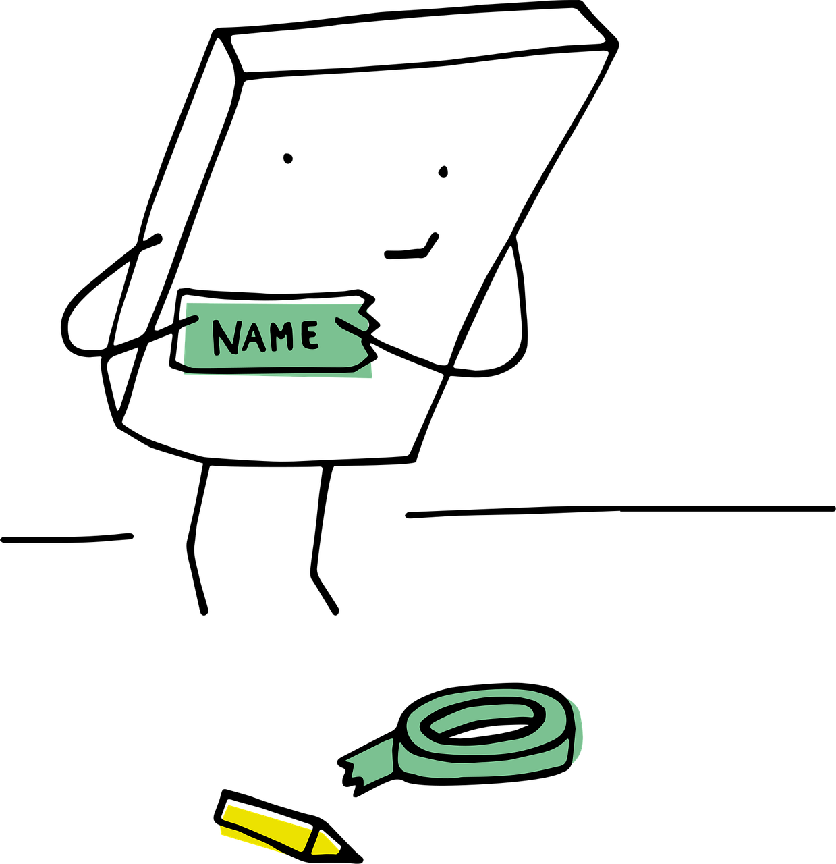
Who are we
Welcome everyone to the team / this years’ edition of the course
  State that there have been interesting/necessary/small/large changes to the course, and that you’re looking forward to running those with the TAs
New team / team-members?
  Introduce yourself and start with a quick round of names and study-background
Get-to-know / team-building: Take ~10-15 minutes for an introductory activity
  Examples on following slides
  Ranging from simple and low threshold to more interactive

Slide 5
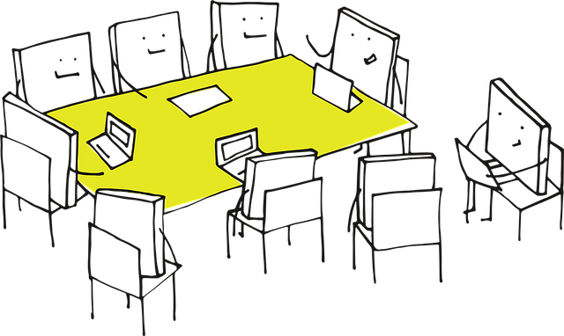
Who: Example activity
Table talk: Teaching highs and lows
Purpose: Share experiences and build empathy
Setup: Place a small stack of index cards or sticky notes at each seat
Activity: Ask each TA to write down:
  One teaching “high” (a moment that went well or felt rewarding)
  One teaching “low” (a challenge or something that didn’t go as planned)
  ….fill in (something you’d like your TAs to share)
Discussion: Go around the table and have each person share their high and low. The teacher can note common themes
Why it works: Encourages storytelling, reveals shared challenges, and sets a collaborative tone

Slide 6

Who: Example activity
Table talk: Pass the question
Purpose: Light, interactive way to learn about each other’s teaching styles and experiences
Setup: Write 3-5 open-ended, teaching-related questions on slips of paper
    “What’s one thing you always do to prepare for a tutorial?”, “What’s a teaching method you’ve seen work really well?”,
  “What’s something you wish you’d known before you started teaching?”, “How do you handle it when students don’t participate?”
  Fold the slips and place them in a bowl or box in the center of the table.
Activity:
  One TA picks a slip, reads the question aloud, and answers it. After answering, they pass the slip to the next person, who adds their own answer or builds on what was said. Continue until everyone has contributed to 2-3 questions
Wrap-up: Briefly highlight common themes or interesting insights. Thank everyone for sharing
Why it works: Encourages everyone to speak, but in a low-pressure way; surfaces diverse perspectives and teaching tips. Feels natural and conversational, perfect for a seated table setting

Slide 7
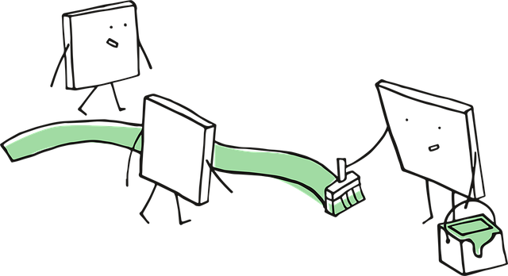
Who: Example activity
Teaching experience timeline
Purpose: Share teaching backgrounds and create a sense of shared journey
Setup: Draw a simple timeline on a whiteboard or flipchart, with “First teaching experience” at one end and “Now” at the other
Activity: Ask each TA to place a sticky note on the timeline with their name and a brief note about a memorable teaching moment (e.g., “First tutorial,” “Taught high school,” “Learned to use breakout rooms”)
Wrap-up: Briefly highlight commonalities or interesting experiences
Why it works: Visual, easy, and reveals diversity without pressure

Slide 8
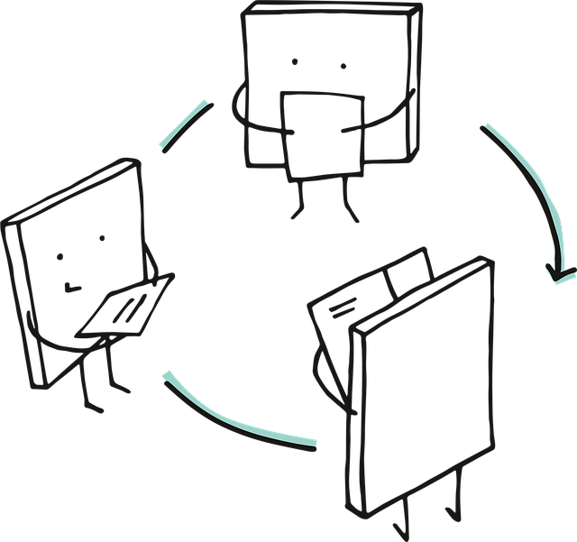
Who: Example activity
Two truths and a teaching lie
Purpose: Lighthearted way to share teaching experiences and values
Setup: Each TA writes down two true statements and one false statement about their teaching experience or philosophy (e.g., “I once taught a class in costume,” “I think group work is overrated,” “I’ve never used a slide deck”)
Activity: TAs share their statements. Others guess the lie. Depending on how many persons, you can make small subgroups
Wrap-up: Ask “What surprised you about each other’s teaching styles?”
Why it works: Reveals personal teaching values and builds rapport

Slide 9
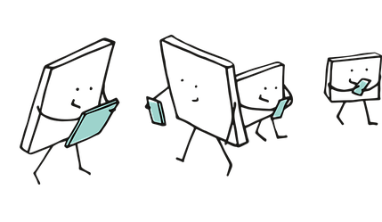
Who: Example activity
Teaching strengths bingo
Purpose: Identify and celebrate individual strengths
Setup: Create a simple bingo card with teaching-related strengths (e.g., “good at explaining complex ideas”, “patient with questions”, “creative with examples”, “organised”)
Activity: TAs mingle and find someone who matches each strength, initialing the box
Wrap-up: Ask a few to share what they learned about their colleagues
Why it works: Encourages interaction, highlights strengths, and is easy to facilitate

Slide 10

Who: example activity
Teaching vision speed dating
Purpose: Quickly share teaching experiences and visions, find common ground
Setup: Each TA pairs with another. Optional: Arrange chairs in two facing rows
Activity: Give each pair 2 minutes to answer:
"What’s one teaching moment you’re proud of?"
  "What’s one thing you hope to achieve as a TA this year?"
  Rotate: After 2 minutes, one row shifts. Repeat 2-3 times
Wrap-up: Ask for volunteers to share a memorable answer
Why it works: Breaks the ice, surfaces teaching values, and shows diversity of experience

Slide 11

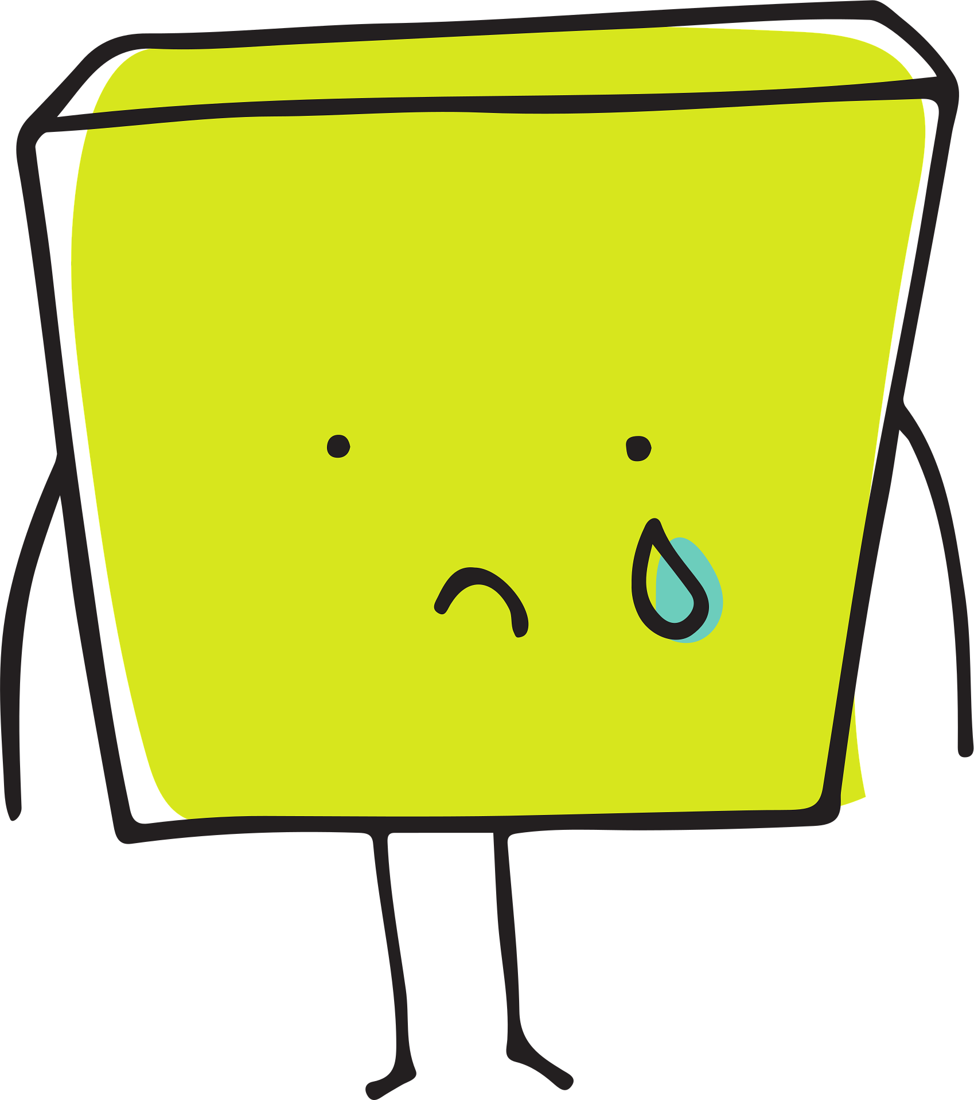
Why are we redesigning the course?
Main challenges in previous design
Challenge 1
    e.g. low attendance overall
Challenge 2
    e.g. less than expected learning outcomes
Challenge 3
    e.g. students seem unprepared for exam
Goals of new design
Goal 1
    e.g. increased attandance in tutorials
Goal 2
    e.g. increased pass rate for course
Goal 3
    e.g. more relevant exam practice
Notes:
Give a clear pointwise overview of the main challenges and goals.
Tip: If TAs give the course multiple times, ask if they recognise these challenges.
NB: Avoid diving into anekdotes and very specific cases of last versions; direct this towards the core of the problems. A specific example can highlight the goal or need, but a memory recall gossip session is now not your aim and will easily slurp up your time.

Slide 12
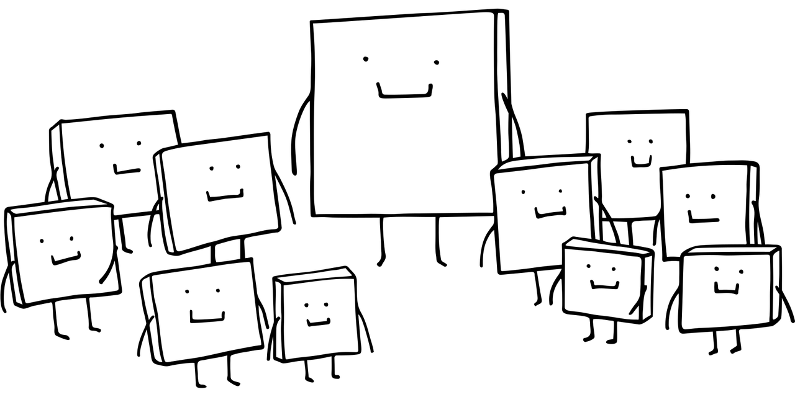
What’s in it for you and the students?
For the students
e.g.: improved learning, better self-assessment, more engagement, more connection with peers, easier to ask questions, easier to stay on track, clear structure of the course to follow, etc.
For you
e.g.: more structured role, more interaction with students, professional development, learning a new teaching style, more room for your personal style, teaching a favorite topic, sharing workload with peers, etc.

Slide 13
The (new/altered) course design
Insert here, or supply on whiteboard or paper, a visual overview; e.g. a timeline, a flowchart, the DataNose overview, a block-schedule, or a list of weeks, lectures, tutorials.
Options and tips:
Highlight key changes / active learning methods
Connect the chosen activities and changes with the ILOs
  ILOs of the course
  ILOs per tutorial/lecture → can be very useful!
Use color coding for educational activities
Notes:
Explain your course design, ideally with a visual.

Slide 14
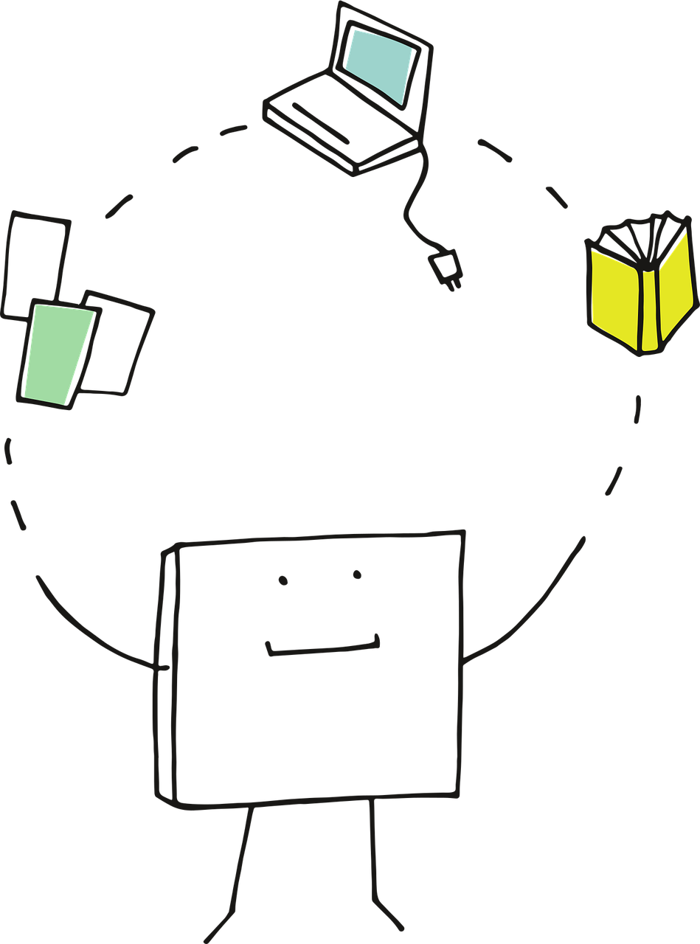
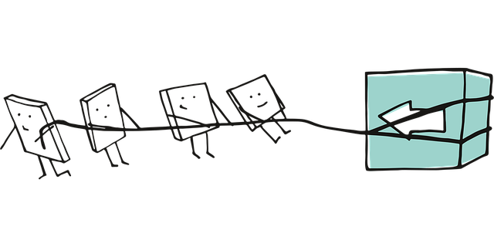
Your role in the new design
Key responsibilities:
  E.g. leading discussions, grading, following lesson plans, walking around and talking to students, do a plenary check-in and check-out, stimulate/guide group-work, correct homework, answer questions via e-mail or canvas, register attendance, calibrate feedback/grades, etc.
Expectations:
  E.g. punctuality, preparation, open / timely communcation, not passively sitting behind desk, etc.
Notes:
Fill in your own key responsibilities and expectations for your TAs here, the examples are for inspiration.

Slide 15
Check
Is the (re)design clear?
Optional: Discuss
Are there any direct (small) suggestions or do you see any direct pitfalls?

Slide 16


Your role as a TA: Are you comfortable?
Let’s discuss:
What roles resonate with you? What do you expect to be fun, what do you think you’ll be good at?
What questions or concerns do you have? What step do you need to tackle those?
Notes:
If you’re trying something new, out-of-the-box, or if the role of the TA is different from what they’ve been used to er expect, consider checking how they feel towards the design.
Focus on positive points. If individual TAs have many concerns due to a certain reason, offer them a private talk about it.

Slide 17

How: Practicalities and divide tasks
Per change / active learning method / new activity, list:
What do we need to do now to implement the new ideas?
Must:
  The schedule be altered?
  Topics be rearranged or added?
  New material be found or made?
  Old material be revised?
  Online items be developed?
  Physical items be designed or prepared?
  The Canvas page be restructured?
  The Study Guide be adapted?
  Etc.
Notes:
If you already have this in mind, present to the TAs what the actual steps are that you’re going to take.
Alternatively, you can do this as a group brainstorm/collection; see next slide.

Slide 18
How: Discuss practicalities and divide tasks
What do we need to do now to implement the new ideas?
Several smaller ideas
  Divide in duo/trio; divide ideas
  Duo/trios take notes on paper or laptop
  Must:
  New material be found or made?
  Old material revised?
  Online items be developed?
  Physical items prepared?
  Etc.
One or two bigger changes
  Per idea, give input as a group
  Collect on whiteboard or flipchart
  Must:
  The schedule be altered?
  Topics be rearranged or added?
  New material be found or made?
  Old material revised?
  Online items be developed?
  Physical items prepared?
  Etc.
Notes:
Optional: Do the ‘how’ session as a joint effort and let TAs think along.

Slide 19
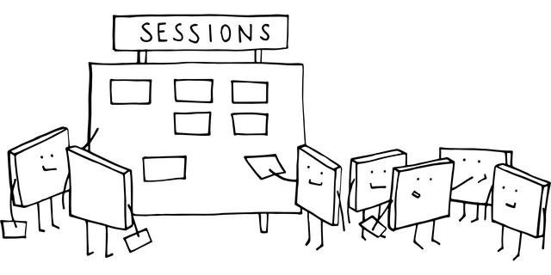
Take action : Who & what
TASKS
What actions will the course coordinator take?
  Design/adapt grading models, design/find/build new content, scheduling decisions and requests, make a basic lesson plan, make exam questions, make online quizzes, adapt study guide, etc.
What tasks can TAs do?
  Revise old assignments, make example answers, tweak lesson plan for themselves, make quiz questions for tutorials, prepare printed/physical material, etc.
Clearly appoint who will do what, and when it has to be finished
Can AI help you in any way?
  Generate quiz / practice questions or true/false/discussion statements, generate exit paper questions about the course material, give you ideas to tweak a certain workflow for more/less students, help you create a basic lesson plan, etc.
Notes:
Be aware of what can be asked of TAs and what falls within their responsibility. They can not have end responsibility for grading models, for example.

Slide 20

Closing
Great that you’ve taken these steps!
Great that you’ve given all this input
Is it clear:
Who/what is the main contact person/medium for the TAs?
What is done in case of illness / unexpected cancellation?
Where can TAs find all the course material?

Slide 21
Optional: Closing check: Are we all on board?
Keep it positive and…
  e.g. ask everyone how they look forward to the course/redesign in one word
  e.g. try to come up with a slogan or tagline for the course
  e.g. on a scale of 1-10, how happy/exited/sure do you feel about….

