Slide 1

TA brainstorm / instruction slides
Basic suggestion slides for hosting a structured brainstorm session with your TAs about (re)designing your course
‘Cell’ images by manfredsteger via Pixabay

Slide 2
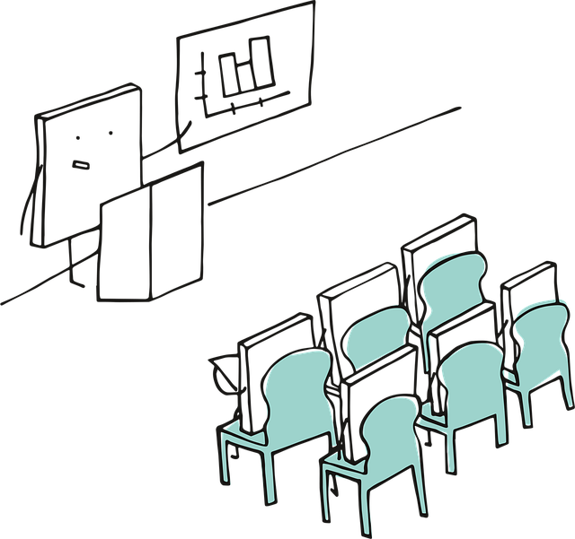
Structure for a TA brainstorm course improvement session
Get to know (~15 minutes)
  Create team-spirit and an open communication structure, everybody knows who is who, and who to reach for what. Use an icebreaker, an introductory round and for example let everyone share a bit about their vision/experience with teaching.
Why do you have a certain course design? (10 minutes)
What are experiences / pitfalls from the previous design, that you want to tackle with active teaching?
What goals do you have with a redesign? What will the students get out of it? And the TAs?
What are we going to do? (10-15 minutes)
Explain step by step what the course plan is, and in which parts the TAs play a role. Name your expectations of them. They will probably play a more active role than just answering questions. Use visual support where possible.
How are we going to do this? → details and fine-tuning (~20 minutes)
Only now dive into the actual practical details: How much time, which materials, which group division, possible lesson plans, schedules, slides, grading models, rubrics, dividing tasks, etc.
Notes:
Discuss the steps involved in giving instructions and get them to think about the necessity of each step and the order in which they should be carried out.
‘Why’ and ‘What’ could potentially be the other way round, but this approach takes you from the abstract to the concrete. First, you secure buy-in, as it were, through validation, so that you capture their attention.
It’s important that the ‘How’ comes at the end, as this prompts action and by then you’ll have lost their attention.

Slide 3
Template slides: Table of contents
Who: Team get-to-know and teaching vision
  Basic slide
  Example activities
Why: Are we doing this
  Basic suggestions slides for defining your goals
What: Is the course plan and teaching style
  Basic suggestion slides for structuring the actual brainstorming
How: Are we going to do it; practicalities
  Basic suggestion slides for filling in the details and appointing tasks

Slide 4
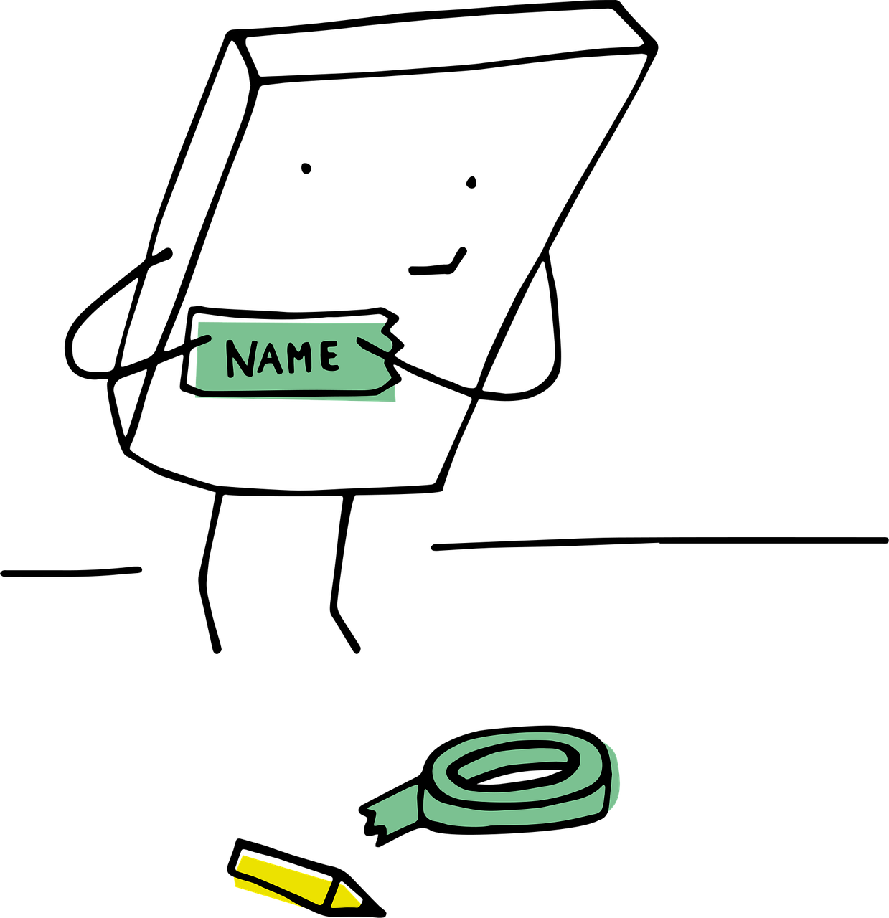
Who are we
Welcome everyone to the team / this years’ edition of the course
  State that there have been interesting/necessary/small/large changes to the course, and that you’re looking forward to running those with the TAs
New team / team-members?
  Introduce yourself and start with a quick round of names and study-background
Get-to-know / team-building: Take ~10-15 minutes for an introductory activity
  Examples on following slides
  Ranging from simple and low threshold to more interactive

Slide 5
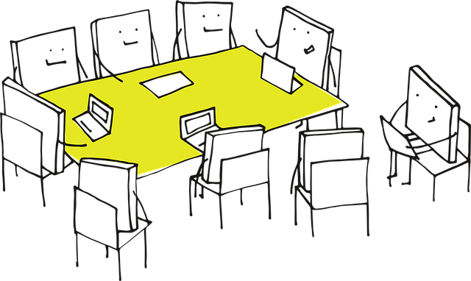
Who: Example activity
Table talk: Teaching highs and lows
Purpose: Share experiences and build empathy
Setup: Place a small stack of index cards or sticky notes at each seat
Activity: Ask each TA to write down:
  One teaching “high” (a moment that went well or felt rewarding)
  One teaching “low” (a challenge or something that didn’t go as planned)
  ….fill in (something you’d like your TAs to share)
Discussion: Go around the table and have each person share their high and low. The teacher can note common themes
Why it works: Encourages storytelling, reveals shared challenges, and sets a collaborative tone

Slide 6

Who: Example activity
Table talk: Pass the question
Purpose: Light, interactive way to learn about each other’s teaching styles and experiences
Setup: Write 3-5 open-ended, teaching-related questions on slips of paper
    “What’s one thing you always do to prepare for a tutorial?”, “What’s a teaching method you’ve seen work really well?”,
  “What’s something you wish you’d known before you started teaching?”, “How do you handle it when students don’t participate?”
  Fold the slips and place them in a bowl or box in the center of the table.
Activity:
  One TA picks a slip, reads the question aloud, and answers it. After answering, they pass the slip to the next person, who adds their own answer or builds on what was said. Continue until everyone has contributed to 2-3 questions
Wrap-up: Briefly highlight common themes or interesting insights. Thank everyone for sharing
Why it works: Encourages everyone to speak, but in a low-pressure way; surfaces diverse perspectives and teaching tips. Feels natural and conversational, perfect for a seated table setting

Slide 7
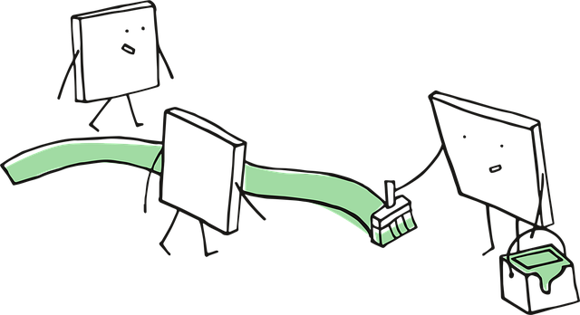
Who: Example activity
Teaching experience timeline
Purpose: Share teaching backgrounds and create a sense of shared journey
Setup: Draw a simple timeline on a whiteboard or flipchart, with “First teaching experience” at one end and “Now” at the other
Activity: Ask each TA to place a sticky note on the timeline with their name and a brief note about a memorable teaching moment (e.g., “First tutorial,” “Taught high school,” “Learned to use breakout rooms”)
Wrap-up: Briefly highlight commonalities or interesting experiences
Why it works: Visual, easy, and reveals diversity without pressure

Slide 8
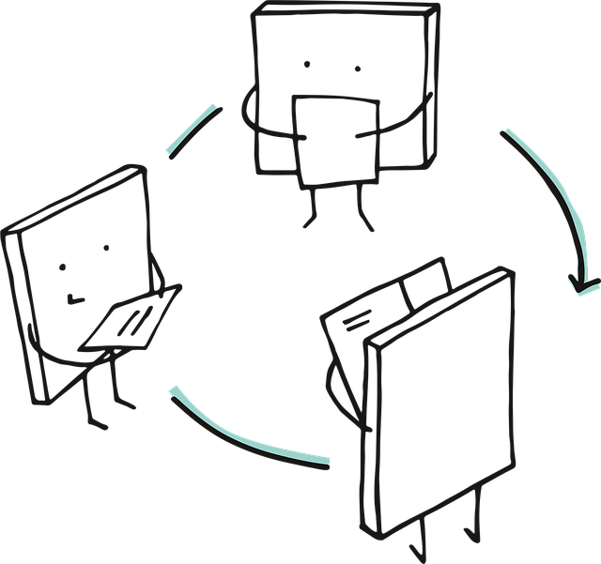
Who: Example activity
Two truths and a teaching lie
Purpose: Lighthearted way to share teaching experiences and values
Setup: Each TA writes down two true statements and one false statement about their teaching experience or philosophy (e.g., “I once taught a class in costume,” “I think group work is overrated,” “I’ve never used a slide deck”)
Activity: TAs share their statements. Others guess the lie. Depending on how many persons, you can make small subgroups
Wrap-up: Ask “What surprised you about each other’s teaching styles?”
Why it works: Reveals personal teaching values and builds rapport

Slide 9
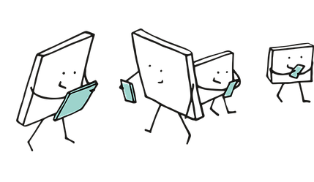
Who: Example activity
Teaching strengths bingo
Purpose: Identify and celebrate individual strengths
Setup: Create a simple bingo card with teaching-related strengths (e.g., “good at explaining complex ideas”, “patient with questions”, “creative with examples”, “organised”)
Activity: TAs mingle and find someone who matches each strength, initialing the box
Wrap-up: Ask a few to share what they learned about their colleagues
Why it works: Encourages interaction, highlights strengths, and is easy to facilitate

Slide 10

Who: example activity
Teaching vision speed dating
Purpose: Quickly share teaching experiences and visions, find common ground
Setup: Each TA pairs with another. Optional: Arrange chairs in two facing rows
Activity: Give each pair 2 minutes to answer:
"What’s one teaching moment you’re proud of?"
  "What’s one thing you hope to achieve as a TA this year?"
  Rotate: After 2 minutes, one row shifts. Repeat 2-3 times
Wrap-up: Ask for volunteers to share a memorable answer
Why it works: Breaks the ice, surfaces teaching values, and shows diversity of experience

Slide 11

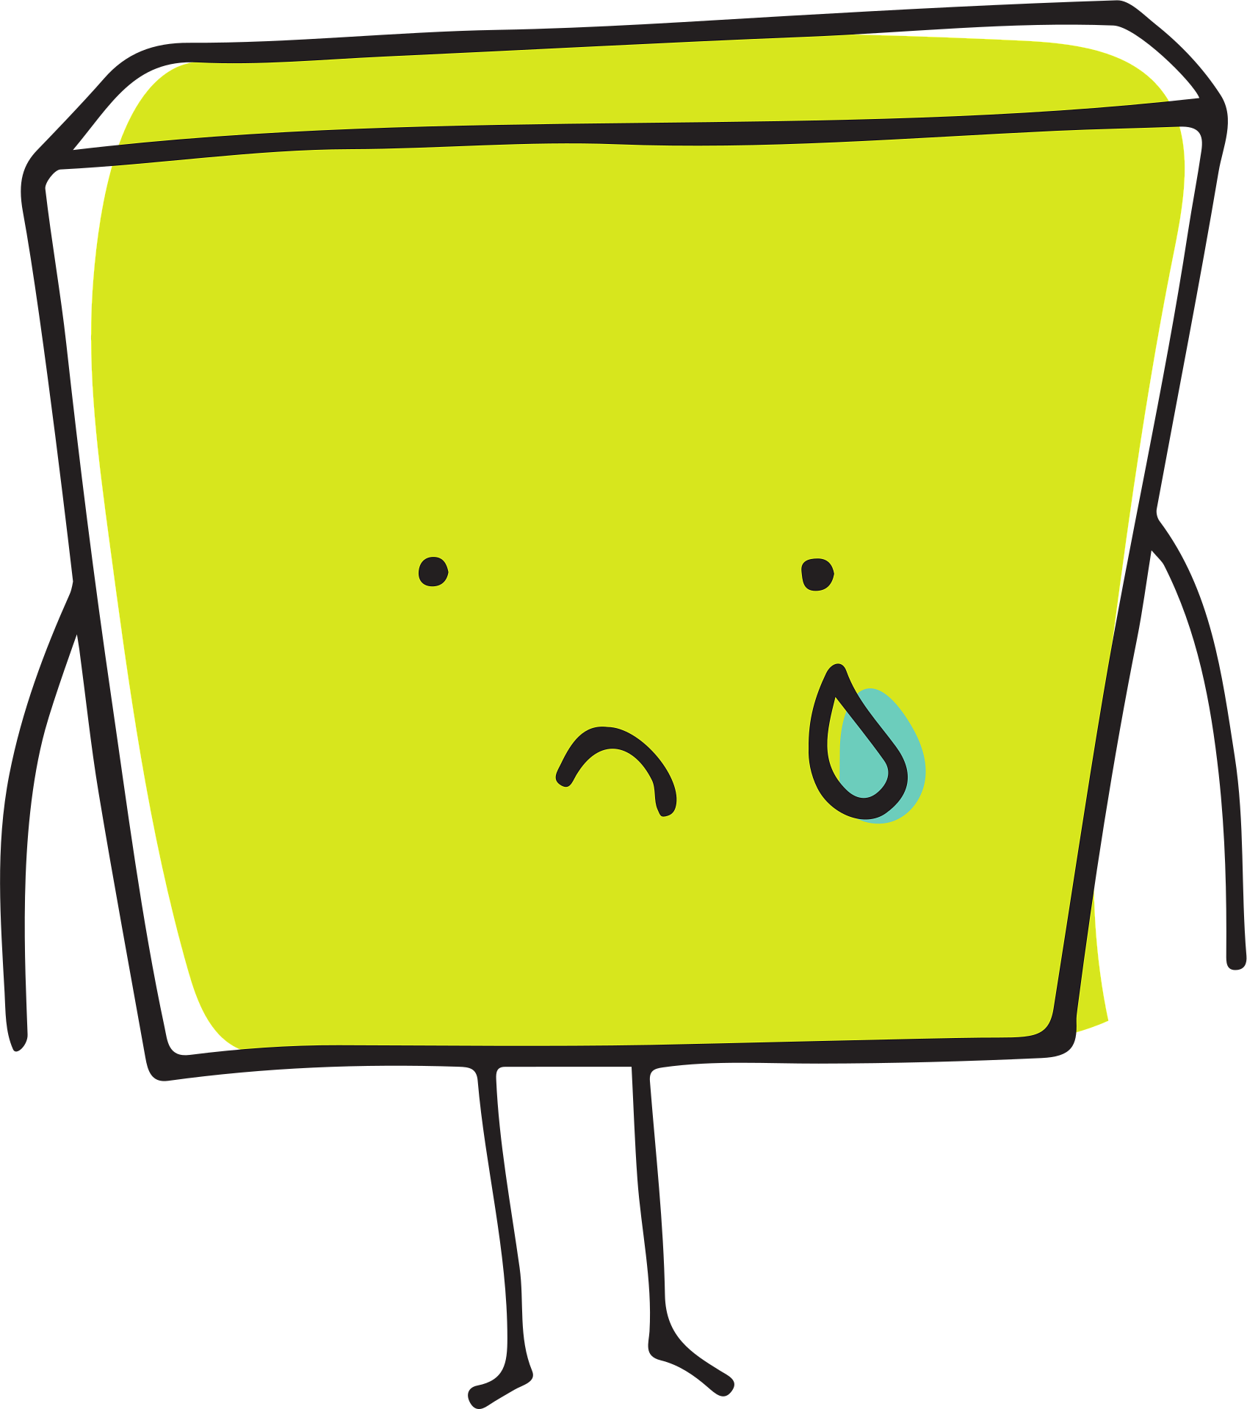
Why are we redesigning the course?
Your input matters!
Main challenges
“What worked and didn’t work in the old design?”
Collect answers on white/blackboard or paper or use sticky notes
Goals of new design
“What do you hope to achieve with the new design?”
Collect answers on white/blackboard or paper or use sticky notes
Notes:
Simple and clear overview of main challenges and goals.
Tip: If TAs give the course multiple times, ask if they recognise these challenges.

Slide 12
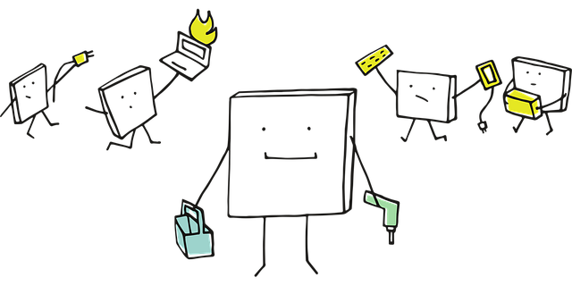
Why: Urgency or main focus point?
What is most urgent to the course coordinator?
What is most urgent to the TAs?
Decide where changes will be made / have most effect
  How much time and space do you have to work on a redesign?
  Start small?
  Go big?

Slide 13
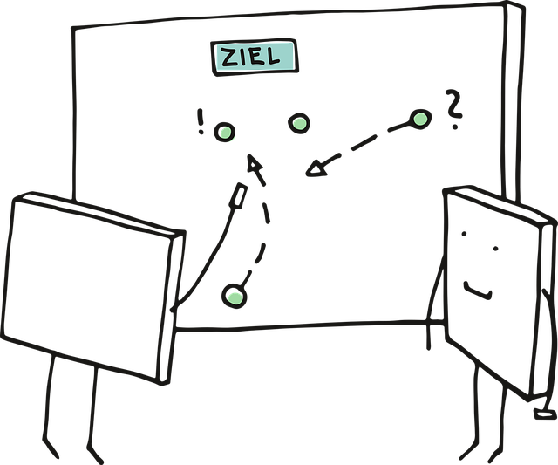
Making changes with a goal
GOAL
Now list for the activities you wish to change or add
  What is the learning goal of each activity, what skill do students have to practice?
  What is the material or content that has to be covered in each activity?
This will help you find active teaching methods that fit the goal and content

Slide 14
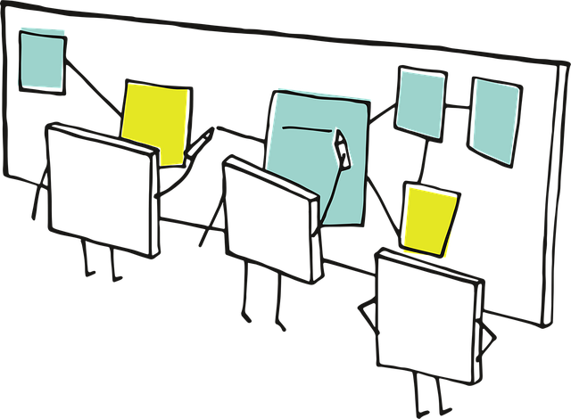
Draft course design:
Your feedback is welcome!
Use a visual of a draft diagram / flowchart / timeline / DataNose overview of the course on a whiteboard or paper, or on screen, and (options, tips):
  Add question marks or highlights for discussion points
  Leave room for annotations or sticky notes
  Use loose components (e.g. sticky notes) for educational activities so you can move them around
  Include the ILOs of the course or per activity
  Use color coding, e.g. for activity types or for ILOs
  Use the STEM activities database for inspiration
  Let UvA AI Chat help you to tweak workflows for your course
  Look for schedule connections that can work in your advantage
    Is a tutorial directly following a lecture? → do a bridging activity that directly connects the two
    Is there a steady weekly structure? That can give a solid base. E.g. "Each Thursday, we work in groups…, and on Mondays, we have…"

Slide 15
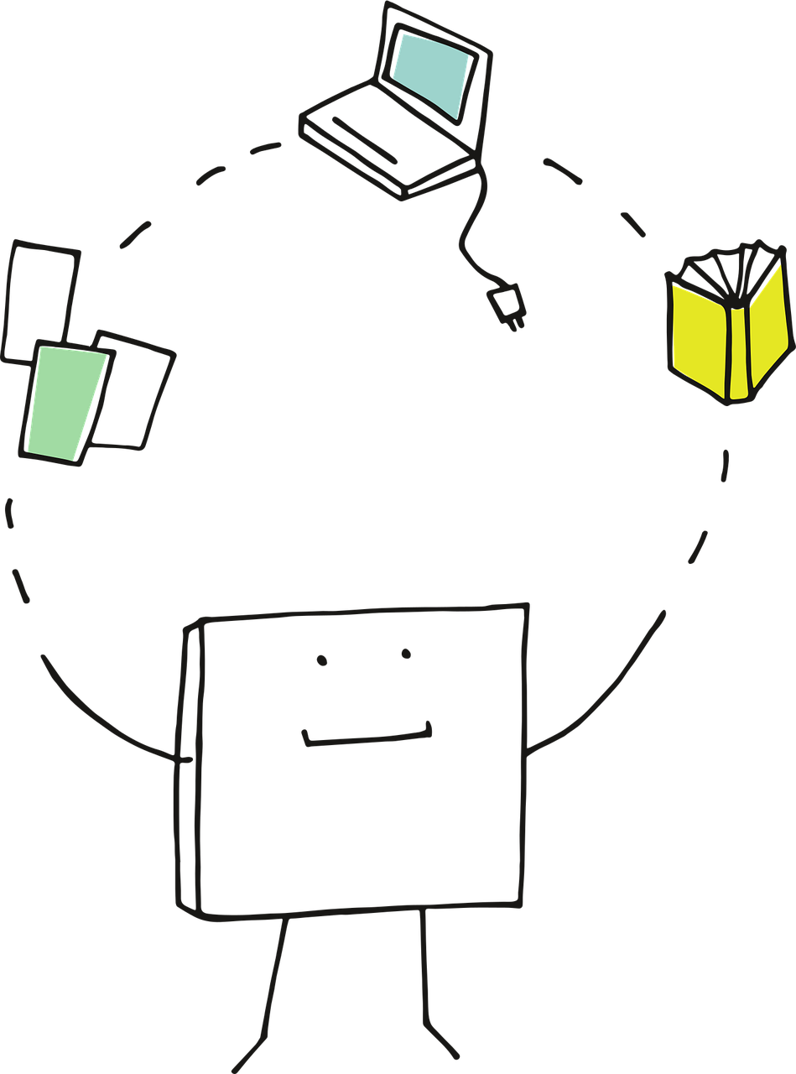
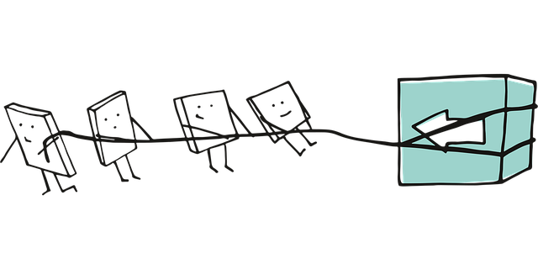
Your roles in the new design
Discuss TA key responsibilities
  E.g. leading discussions, grading, following lesson plans, walking around and talking to students, do a plenary check-in and check-out, stimulate/guide group-work, correct homework, answer questions via e-mail or canvas, register attendance, calibrate feedback/grades, etc.
What are the coordinators expectations?
  E.g. punctuality, preparation, open / timely communcation, not passively sitting behind desk, etc.
Notes:
Fill in your own key responsibilities and expectations here, the examples are for inspiration.

Slide 16


Your role as a TA: Are you comfortable?
Let’s discuss:
What roles and tasks resonate with you? What do you expect to be fun, what do you think you’ll be good at?
What questions or concerns do you have? What step do you need to tackle your concerns or discomfort?
Notes:
If you’re trying something new, out-of-the-box, or if the role of the TA is different from what they’ve been used to er expect, consider checking how they feel towards the design.

Slide 17
How: Discuss practicalities and divide tasks
What do we need to do now to implement the new ideas?
Several smaller ideas
  Divide in duo/trio; divide ideas
  Duo/trios take notes on paper or laptop
  Must:
  New material be found or made?
  Old material revised?
  Online items be developed?
  Physical items prepared?
  Etc.
One or two bigger changes
  Per idea, give input as a group
  Collect on whiteboard or flipchart
  Must:
  The schedule be altered?
  Topics be rearranged or added?
  New material be found or made?
  Old material revised?
  Online items be developed?
  Physical items prepared?
  Etc.
Notes:
Optional: Do the ‘how’ session as a joint effort and let TAs think along.

Slide 18
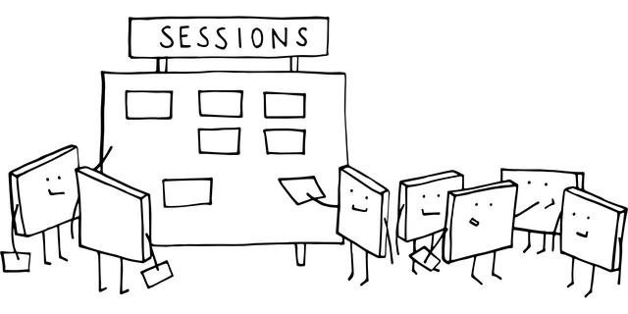
Take action : Who & what
TASKS
What actions will the course coordinator take?
  Design/adapt grading models, design/find/build new content, scheduling decisions and requests, make a basic lesson plan, make exam questions, make online quizzes, adapt study guide, etc.
What tasks can TAs do?
  Revise old assignments, make example answers, tweak lesson plan for themselves, make quiz questions for tutorials, prepare printed/physical material, etc.
Clearly appoint who will do what, and when it has to be finished
Can AI help you in any way?
  Generate quiz / practice questions or true/false/discussion statements, generate exit paper questions about the course material, give you ideas to tweak a certain workflow for more/less students, help you create a basic lesson plan, etc.
Notes:
Be aware of what can be asked of TAs and what falls within their responsibility. They can not have end responsibility for grading models, for example.

Slide 19

Closing
Great that you’ve taken these steps!
Great that you’ve given all this input
Is it clear:
Who/what is the main contact person/medium for the TAs?
What is done in case of illness / unexpected cancellation?
Where can TAs find all the course material?

Slide 20
Optional: Closing check: Are we all on board?
Keep it positive and…
  e.g. ask everyone how they look forward to the course/redesign in one word
  e.g. try to come up with a slogan or tagline for the course
  e.g. on a scale of 1-10, how happy/exited/sure do you feel about….

