Slide 1
Peer-consultation (Dutch: intervisie)
A structured way to give collegial advice on a specific work situation.
The goal is not to convince but to clarify a problem or question and receive ideas and suggestions.
NOT: ‘borrel’ club about work / therapy group / complain session / about past situations with no urgency / not listening
Brings: different perspectives, the core of the problem, a moment of reflection, support and trust, inspiration, growth in your competencies.
Notes:
Vragen of iemenad al ervaring met intervisie heeft, vrgaen wat die ervan weet. Vervolgens aanvullen met info van de slide.
Toegevoegde waarde:
Different perspective on a situation
Core of a problem
Support and confidence
Moment voor reflectie met als doel te groeien in je competenties en expertise op te bouwen

Slide 2
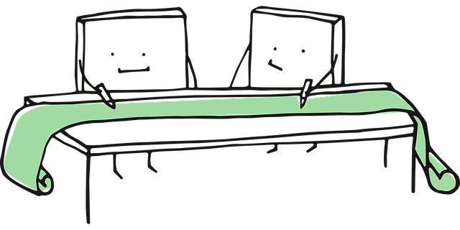

Key rules for peer-consultation
Participation is voluntary.
Guarantee each other security and trust: what is discussed in the group stays in the group.
Participants speak on a completely equal basis (including the facilitator).
The person presenting the case may set their boundaries at any time and has the final say.
Respect for each other and everyone’s contributions.
A structured and systematic exploration of the case, with a focus on investigation and/or providing advice.
The facilitator does not participate but ensures the process is followed (keeps track of time, ensures everyone has the same goal in mind, and that the situation remains safe).
Everyone shares responsibility for the process and for maintaining the discipline of the chosen method.
Peer-consultation time means full attention. No phones, laptops, or other tasks in the background.
‘cell’ images by Manfred Steger via pixabay.com
Notes:
Geen afleiding, dus geen laptops en telefoons!

Slide 3

Gossip method
0. Select a facilitator/time keeper, and case owner
Introduction of the case (5 min) by the case owner
Explorative questions (5 min) by the group. Do not give advise / opinion.
Gossip and problem definition (15 min)
  Case owner sits with their back to the group and makes notes for themselves. Is NOT allowed to join in / speak up.
  Group debates thoughts, ideas and feelings concerning the case.
  Each group member defines what they think the ‘real’ problem is.
Final reaction from case owner (5 min)
‘cell’ images by Manfred Steger via pixabay.com
Notes:
30 min nu nog (eerste stap 0 nu al gedaan, maar normaliter ook nog bepalen)
Stap 2 kan je cirkel gewijs doen zodat iedereen vragen stelt, of popcorn stijl (you pop when you’re ready).
Stap 3, zorg dat je genoeg tijd hebt voor het rondje herdefinering van ‘het probleem’, instrueer eventueel: maak nu allemaal de zin af: ‘volgens mij is het echte probleem dat…/ de kern van deze casus dat…’ met niet meer dan 1 zin!
Ter nabespreking: waardevolle aan intervisie is dat vaak niet alleen de inbrenger hiervan leert. Wat hebben anderen geleerd van deze intervisie ervaring?
Eventueel koppelen aan de waarde van de lesgeefpraktijk te evaluaren en hierop te reflecteren. Zoek elkaar dus op! Kan dit eventueel ook onderling organiseren. Nog heel veel andere intervisie methodes!

