Slide 1

Check-in
Check-in example questions for your students
‘Cell’ images by Manfred Steger via Pixabay.com

Slide 2
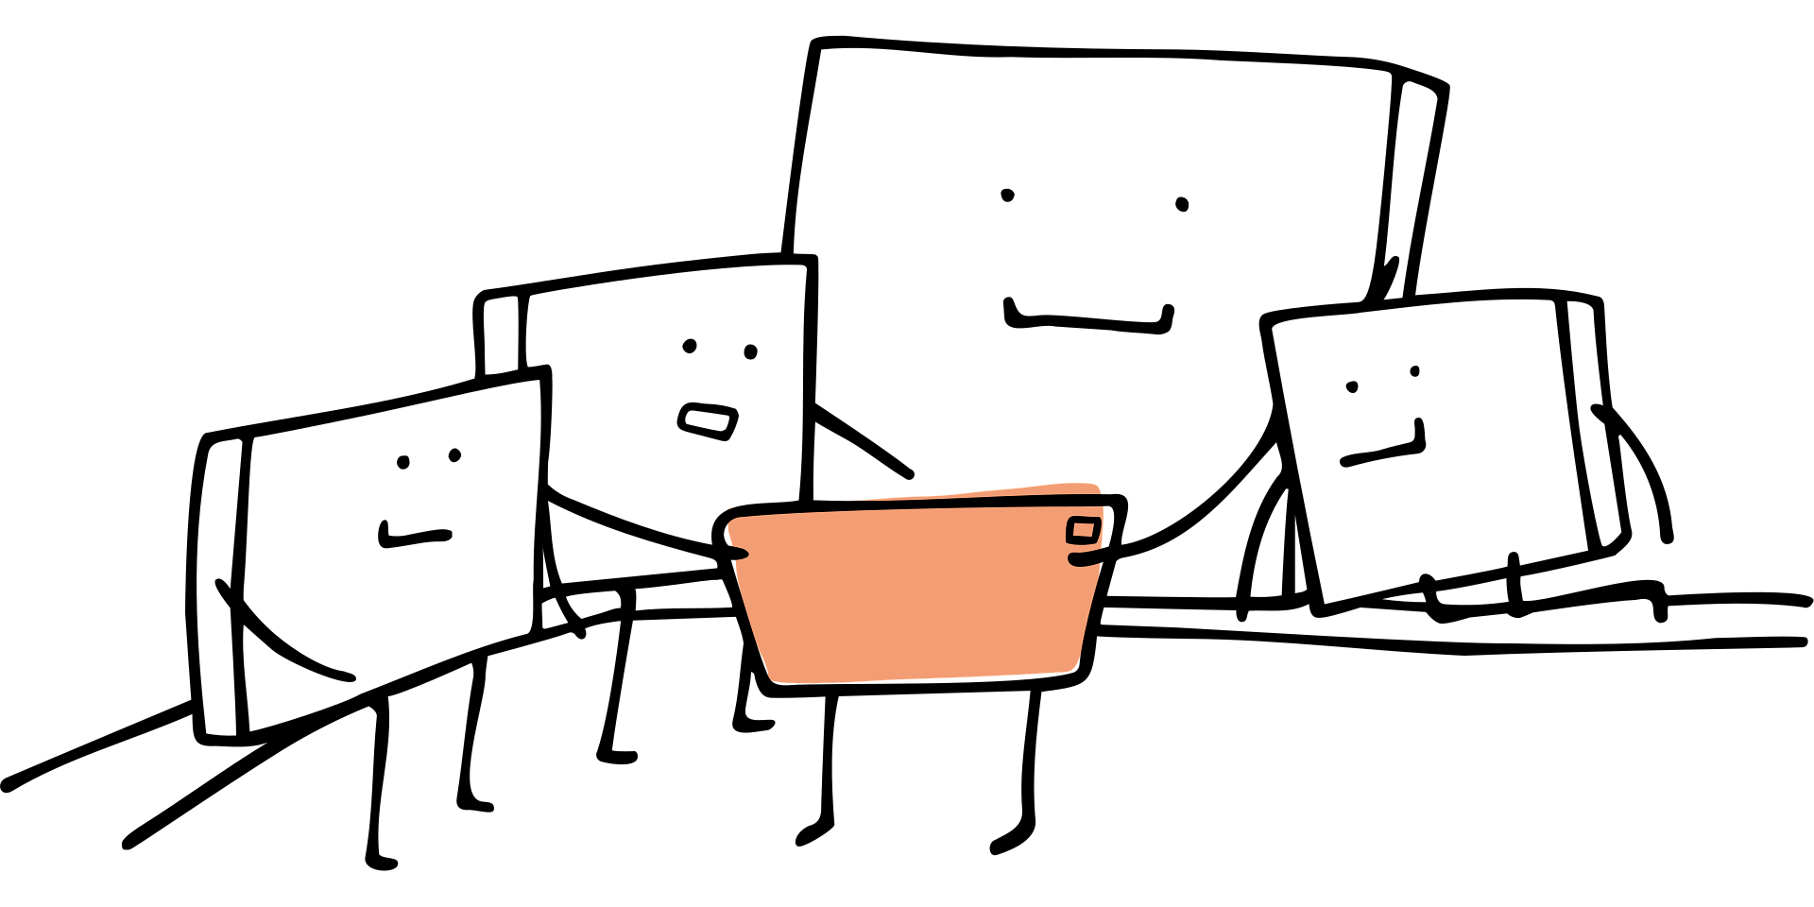
Check-in questions
Topic & difficulty
On a scale of 1-10, how far do you think you comprehend topic X? (Wooclap)
Of these 3 lecture topics, which one did you enjoy most / find most difficult? (Wooclap, vocal)
How was todays lecture for you? What word first comes to mind? (Vocal or wordcloud)
Rank these topics in order how well you understand them. (Wooclap)
Is there a topic you would like extra explanation for? (Multiple choice)

Slide 3
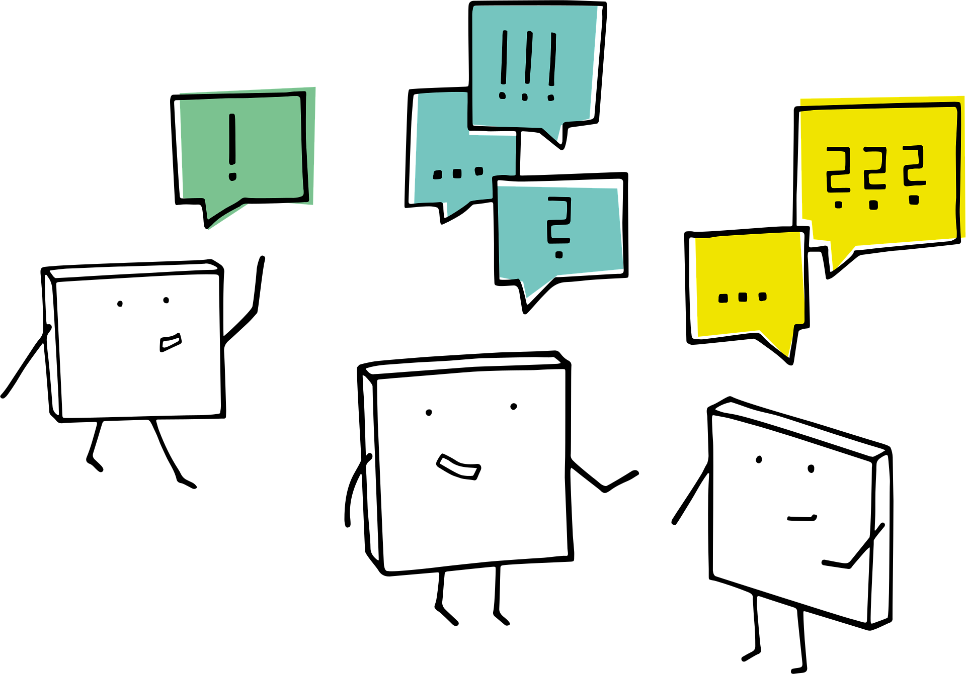
Check-in questions
Content
Is this statement true or false: [statement about the lecture topic]
A few multiple choice questions about the lecture content
Can you think of an example when to use method X from the lecture?
Can you predict the next step in this example? (Think-pair-share)

Slide 4
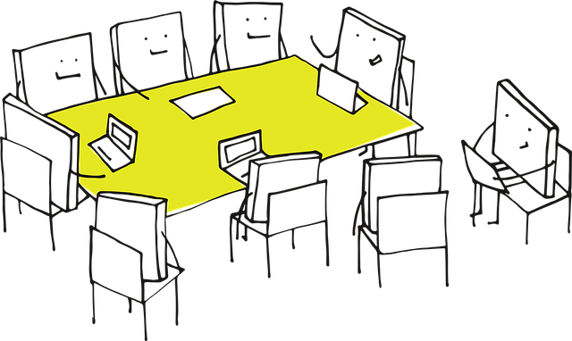
Check-in questions
Group/energy
On a scale of 1-5, how is your energy level?
This is the last tutorial before the exam, how is your stress level?
How is the studying going? (Can be multiple choice)
Has anyone noticed how …?

Slide 5
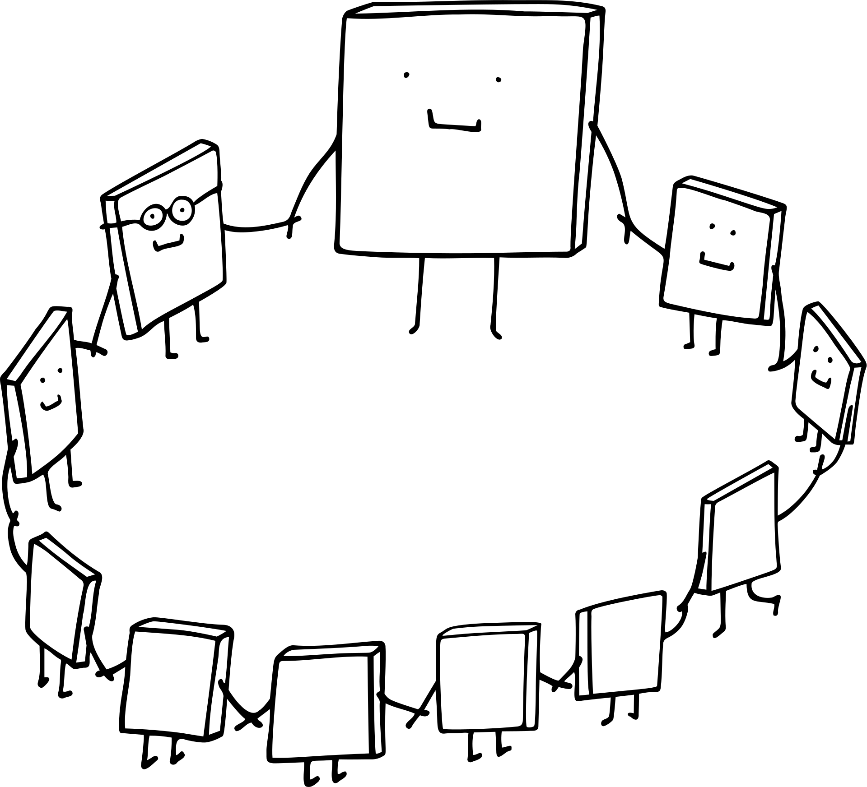
Physical activity exercises
Draw an invisible line in the room and ask: "How much do you agree with this statement? Stand here for total agreement, and there for not at all, and in between as suits your agreement level." Also works for "how’s your energy level?"
Do a short ‘petje op-petje af’ quiz: Students answer a two-option question by standing up or remaining seated. When students are wrong, they ‘lose’; so every round there will be less ‘competitors’. Or have students all stand and raise a hand for yes. Each student who is wrong sits down, leading to fewer students standing
Do your check-in in front of the room with everyone standing with you in a group/circle. After the check-in, everyone can go sit down and work
A short breathing exercise

