Slide 1

Check-in
Check-in example questions for your TAs
‘Cell’ images by Manfred Steger via Pixabay.com

Slide 2
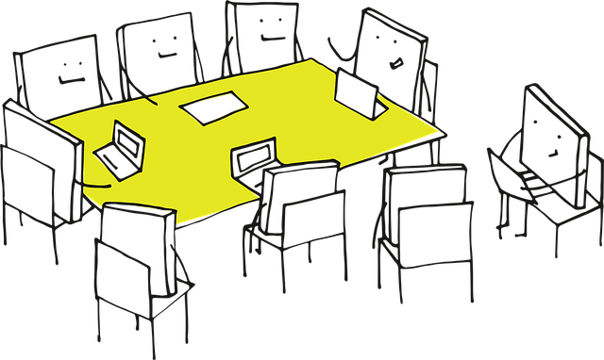
Teaching highs and lows
Purpose: Share experiences and build empathy
Setup: Place a small stack of index cards or sticky notes at each seat
Activity: Ask each TA to write down:
  One teaching “high” (a moment that went well or felt rewarding)
  One teaching “low” (a challenge or something that didn’t go as planned)
  ….fill in (something you’d like your TAs to share)
Discussion: Go around the table and have each person share their high and low. The teacher can note common themes
Why it works: Encourages storytelling, reveals shared challenges, and sets a collaborative tone

Slide 3

Pass the question
Purpose: Light, interactive way to learn about each other’s teaching styles and experiences
Setup: Write 3-5 open-ended, teaching-related questions on slips of paper
    “What’s one thing you always do to prepare for a tutorial?”, “What’s a teaching method you’ve seen work really well?”,
  “What’s something you wish you’d known before you started teaching?”, “How do you handle it when students don’t participate?”
  Fold the slips and place them in a bowl or box in the center of the table.
Activity:
  One TA picks a slip, reads the question aloud, and answers it. After answering, they pass the slip to the next person, who adds their own answer or builds on what was said. Continue until everyone has contributed to 2-3 questions
Wrap-up: Briefly highlight common themes or interesting insights. Thank everyone for sharing
Why it works: Encourages everyone to speak, but in a low-pressure way; surfaces diverse perspectives and teaching tips. Feels natural and conversational, perfect for a seated table setting

Slide 4
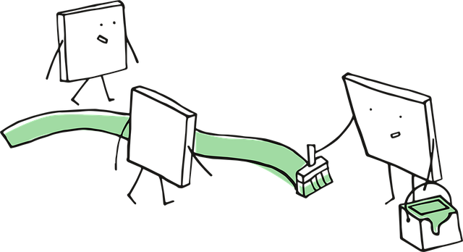
Teaching experience timeline
Purpose: Share teaching backgrounds and create a sense of shared journey
Setup: Draw a simple timeline on a whiteboard or flipchart, with “First teaching experience” at one end and “Now” at the other
Activity: Ask each TA to place a sticky note on the timeline with their name and a brief note about a memorable teaching moment (e.g., “First tutorial,” “Taught high school,” “Learned to use breakout rooms”)
Wrap-up: Briefly highlight commonalities or interesting experiences
Why it works: Visual, easy, and reveals diversity without pressure

Slide 5
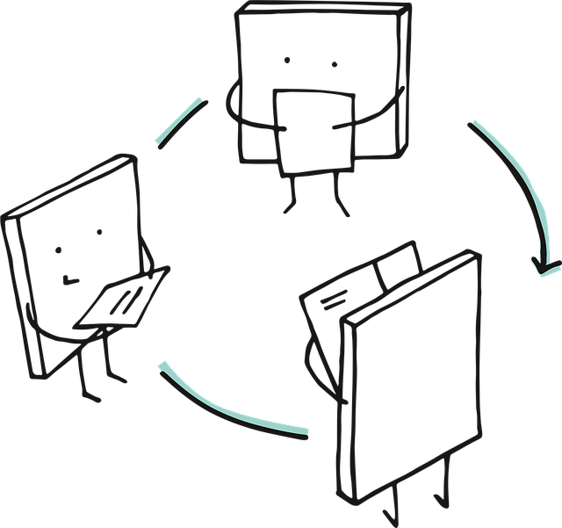
Two truths and a teaching lie
Purpose: Lighthearted way to share teaching experiences and values
Setup: Each TA writes down two true statements and one false statement about their teaching experience or philosophy (e.g., “I once taught a class in costume,” “I think group work is overrated,” “I’ve never used a slide deck”)
Activity: TAs share their statements. Others guess the lie. Depending on how many persons, you can make small subgroups
Wrap-up: Ask “What surprised you about each other’s teaching styles?”
Why it works: Reveals personal teaching values and builds rapport

Slide 6
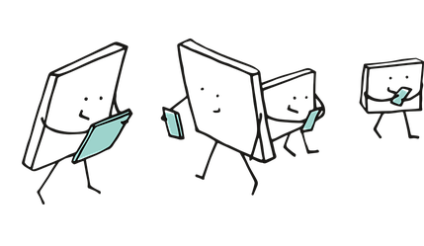
Teaching strengths bingo
Purpose: Identify and celebrate individual strengths
Setup: Create a simple bingo card with teaching-related strengths (e.g., “good at explaining complex ideas”, “patient with questions”, “creative with examples”, “organised”)
Activity: TAs mingle and find someone who matches each strength, initialing the box
Wrap-up: Ask a few to share what they learned about their colleagues
Why it works: Encourages interaction, highlights strengths, and is easy to facilitate

Slide 7
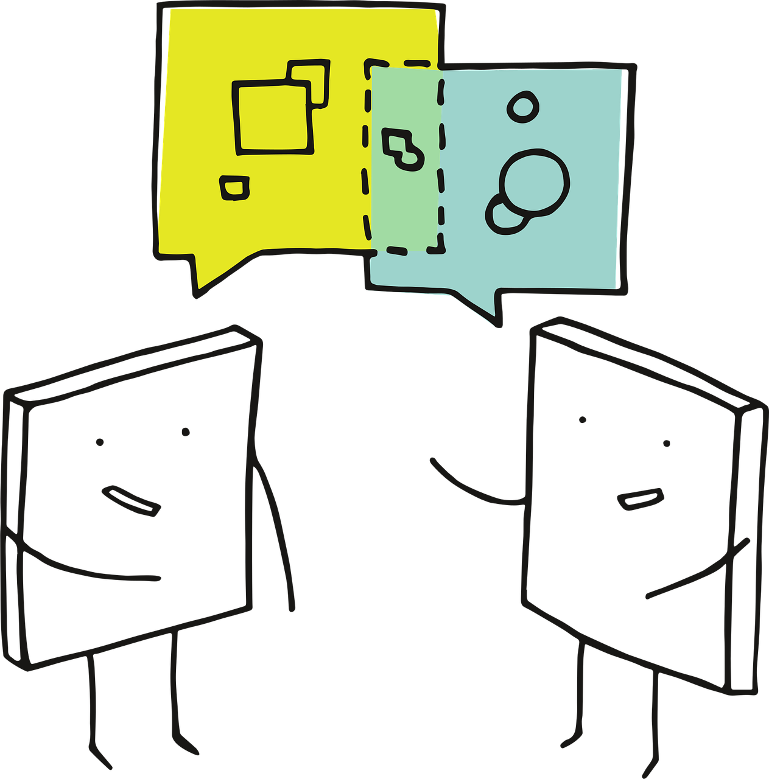
Teaching vision speed dating
Purpose: Quickly share teaching experiences and visions, find common ground
Setup: Each TA pairs with another. Optional: Arrange chairs in two facing rows
Activity: Give each pair 2 minutes to answer:
"What’s one teaching moment you’re proud of?"
  "What’s one thing you hope to achieve as a TA this year?"
  Rotate: After 2 minutes, one row shifts. Repeat 2-3 times
Wrap-up: Ask for volunteers to share a memorable answer
Why it works: Breaks the ice, surfaces teaching values, and shows diversity of experience

