Slide 1
Tutorial: … | Lecturer: …
Tutorial goal Optional: TA personal goal | Goal: Exercises:
Tutorial component | Time indication | Activity
1. Plenary introduction / activation | 5 mins | Check-in: [1st tutorial] Introductions Share expectations, structure, list of exercises, and time/planning Plenary check-in activity suitable for TA and/or topic Link to lecture: Brief check/quiz of content, are there questions, etc.
2a. Content part 1 | 40 mins | 1. Worked example of 1 assignment Including interactive moments 2. Active student work Preferable also with peer interaction
Break | 15 mins
2b. Content part 2 | 40 mins | Continue student work or introduce other format (e.g. individual work if part 1 was group work)
3. Plenary closing | 5 mins | Wrap-up & check-out: Provide short summary Brief formative check (e.g. one minute paper or exit ticket) Homework preview Positive closing remark or super short activity
Prepare: … | Bring to classroom: …

Slide 2
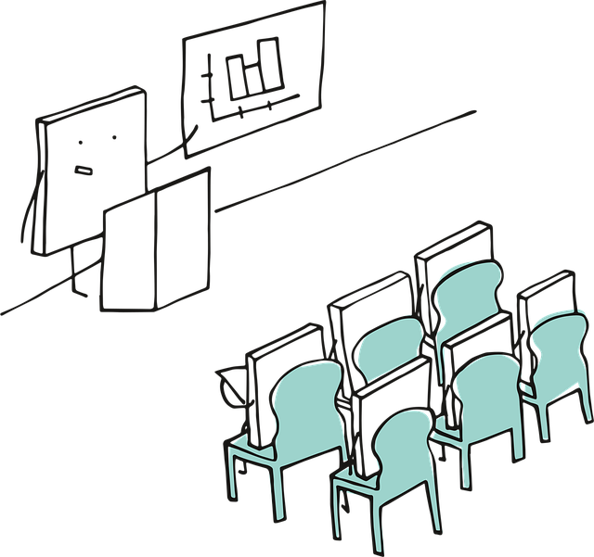
Clear instructions for a smooth lesson
Motivate your students for your assignment
Why are we going to do this?
Validate the purpose or usefulness of the assignment; what does it bring students (short / long term)?
What are we going to do?
Explain step by step. Name your expectations. Use visual support.
Check if it is clear
Wait long enough for students to ask questions.
How are we going to do this? → Call to action
Only now explain practical matters: How much time, which materials, which group division? What will you do, walk around, be there?
Hand out your handouts at the end, because as soon as you do this, you will lose attention!

Slide 3
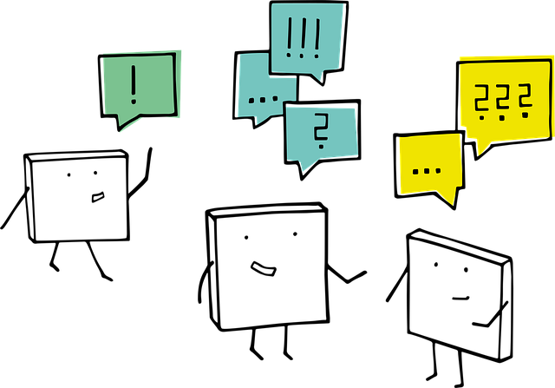
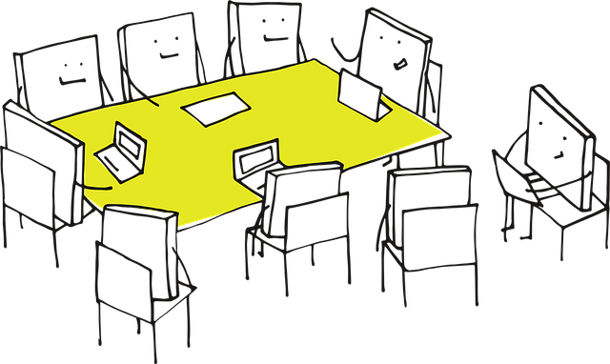
Easy-to-implement activities and tips for tutorials
Welcome students in
Being seen and appreciated for being present can mean a world of difference to a student
Walk around and be visible; no sitting behind a desk waiting for questions
Optional: Create some help/template questions for addressing students
How to support and react to the answer “Oh yeah everything is fine”
Check the scaffolding checklist
Half ‘n half:
1st part of tutorial is interactive and guided – active learning workflow/ group work
2nd part of tutorial is individual work and questions
Always sit in groups or U-shape, also for individual work
Easier to walk around and interact
Students tend to discuss with peers more easily in this setting
Easier to explain / help a small group
Easier to ask for peer explanation at a group table; stimulate students to explain to each other

Slide 4
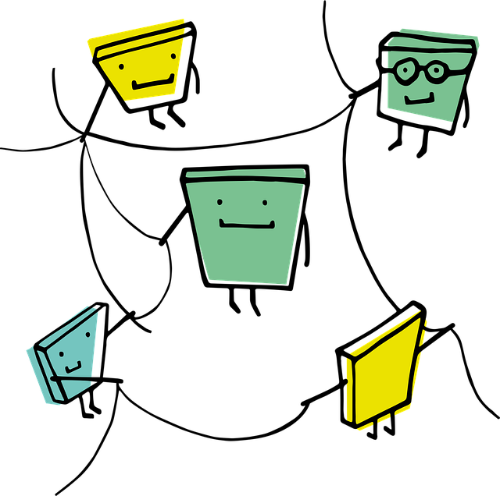
Small activating actions
Make plenary explanations interactive
Use think-pair-share to let student predict a next step or do short multiple-choice questions (“Is the next step a, b or c, what do you think?”) or raise hand questions.
Explanations in sub-groups
Explain a concept at a (group) table or specified corner of the room, ideally with a whiteboard. Students who want to hear the explanation join at this table and actively participate. Students who don’t need it can work for themselves. Can be done for multiple topics at various moment; announce your planning on the board.
Structuring assignments in the group
Students who sit in a small group work individually but check and compare their answers at appointed time-points; TA announces when. Students note what is still unclear and what they would like to ask the TA.
A peer review round. At a given time (by TA), students will review their neighbours’ answers to given assignments and give feedback. Note where they differ so they can discuss later.
A before-the-break job
Small teams or duo’s get an assignment that should be finished/handed in before the break. After the break, this can be used to go deeper into the material, or do a plenary reviewing/explanation, etc.
Organise a formative playful prize question for those who want to participate. Before the break, students answer a question about the material that goes a bit deeper than the exam / has a societal connection (anything that makes it more than simple basic). After the break, the winner is announced.
Post-break quiz
Get back into the vibe after the break with a few true/false statements or questions to be answered by raising hands or stand/sit. UvA AI Chat can help make quiz questions.

Slide 5
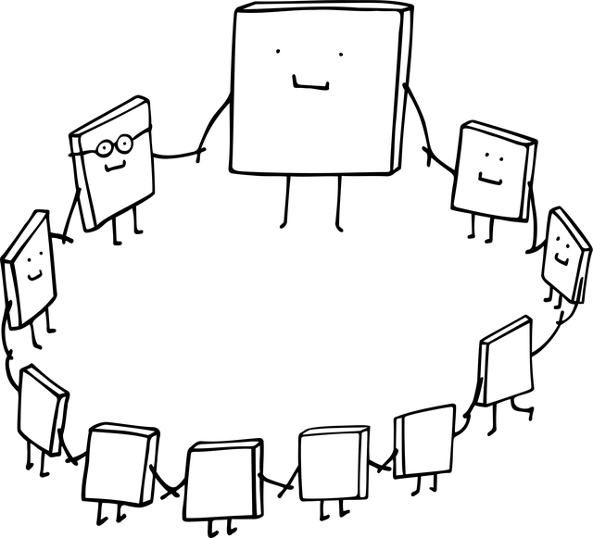
Activating tips for plenary closing
Can be combined with a summary / preview
Exit paper
Students end class by answering two questions for themselves (on paper): “What is the most important thing you learned?” and “What is still unclear?” A TA can collect unclarities and address them next time.
1-3 short quiz-questions in exam style
Project it on a slide; answering them can be digital or on paper.
This takes a bit more time, specially if questions come up. Course coordinator can pre-make the slides with questions and answers.
Can also be an introduction.
‘Circle is complete’
Return to a topic or activity that was addressed in the introduction / check-in.
Appreciate
Appreciate the presence and input of the students who were there.

