Slide 1
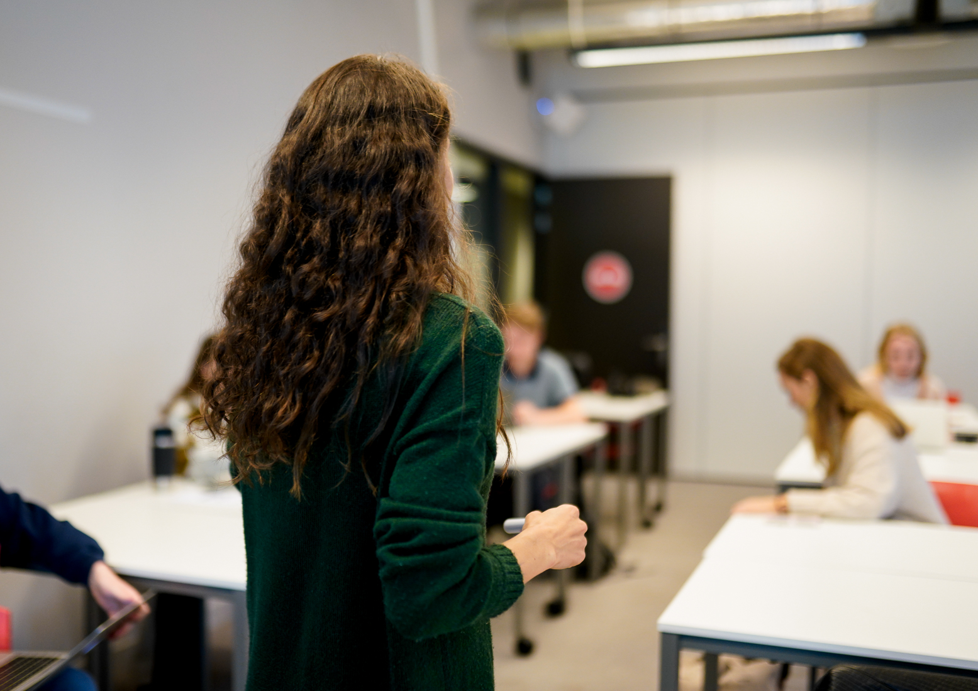





ABC Learning Design

Slide 2

ABC Learning Design
With this PowerPoint and the attached instructions you will be able to get started on the (re)design of a course, following the ABC Learning Design method.
The TLC Humanities also offers workshops on ABC Learning Design.
This is a read-only-file. Want to get started on the (re)design of a course?
  Go to file > save as > select a location to save the file
  Open the PowerPoint in ‘normal’ view

Slide 3
How do I use this PowerPoint?
(Re)designing a course is done in 3 steps:
Fill out the 'start sheet'
  Instructions: see slide 3
Work on the storyboard
  First choose your learning activities: see slide 6
  Then choose your teaching methods: see slide 8
Make an action plan
Questions?
  Contact TLC Humanities: tlc-fgw@uva.nl.

Slide 4
Digital 'start sheet'
Fill out the information about the course
Use the stars to indicate the ratio between different learning activities in the web.
  Blue = current situation
  Yellow = desired situation
  Please also place a star on the bottom bar of the page. This will allow you to indicate the difference between student activities taking place inside or outside contact hours (you can use the same colour instructions).
At the end of your design session, you will come back to the digital start sheet.
  You will then use the red star to fill out the web (according to what you created).

Slide 5





ABC learning design – Start sheet
Programme of study:
Course name:
Indicate: designing a new course or redesigning an existing course
Teachers:
Knowledge acquisition
Production
Collaboration
Course summary
(Write a short 'tweet-style' summary about the course:
Reflection
Practice
Discussion
Investigation
@ABC_LD
Learning activities graph
What does the desired distribution of learning activities look like for the new or redesigned module?
(Colour 1: at the start of the workshop) (Colour 2: the situation desired by the team)
(Colour 3: at the end of the workshop)
Outside contact hours
During contact hours
Variety in learning activities
How much variation is there in your course at the moment? (Colour 1)
What would be the desired situation? (Colour 2)
How varied is the course after completing this workshop? (Colour 3)

Slide 6
Digital storyboard: learning activities
Use the cards to read about different the learning activities.
  If you don't have a hard-copy of the cards yet, please request them by sending an email to tlc-fgw@uva.nl
In the next slide, drag a digital card to the corresponding week number and place it ‘inside’ or ‘outside’ the contact hours.
  At times a card might need to be brought to the foreground: right-click > bring to the front / foreground
  Not enough cards? Copy and paste the card(s).

Slide 7
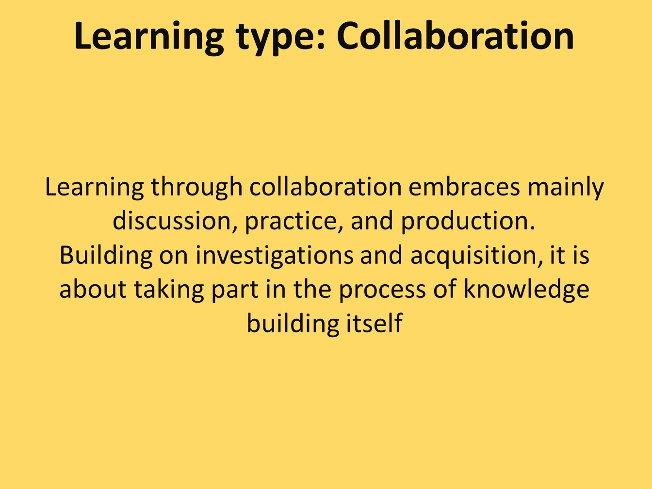
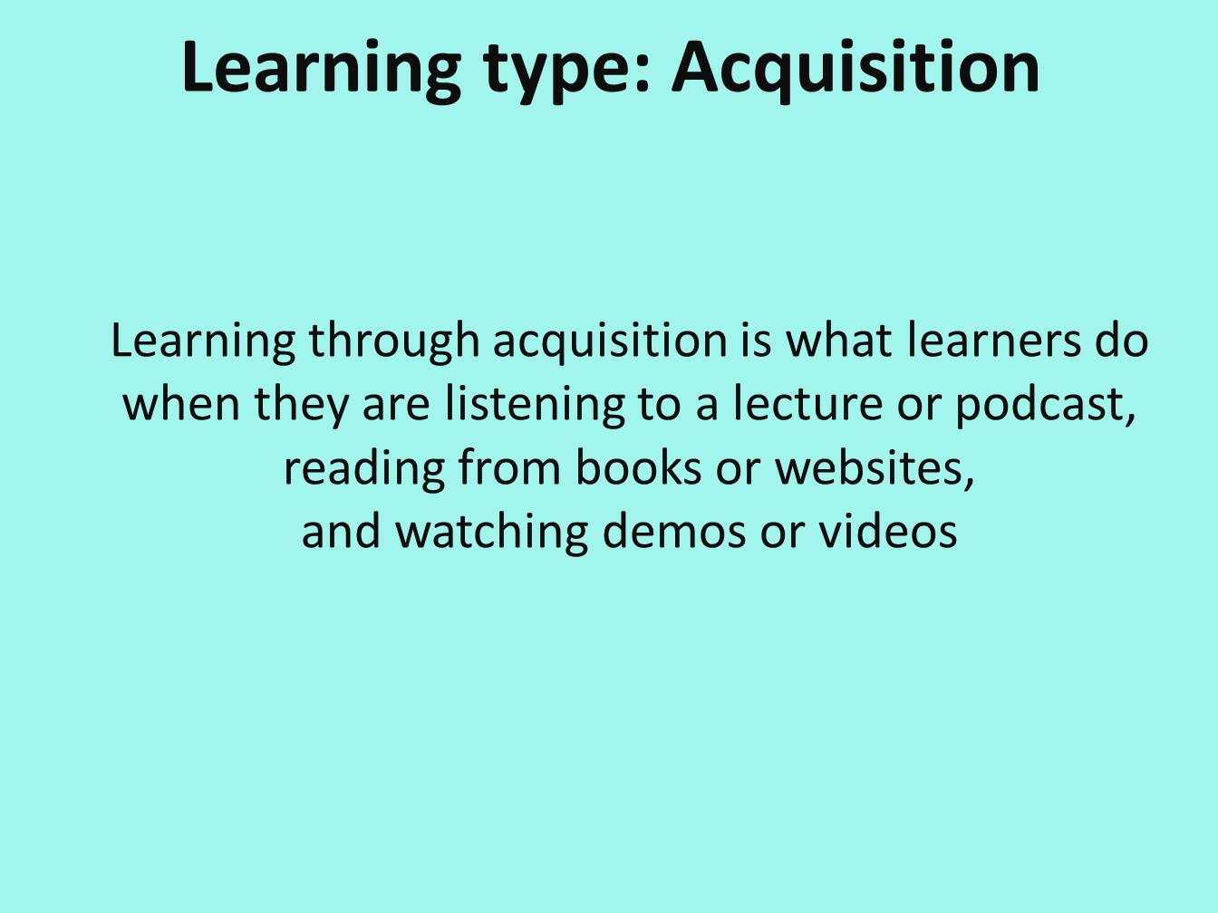
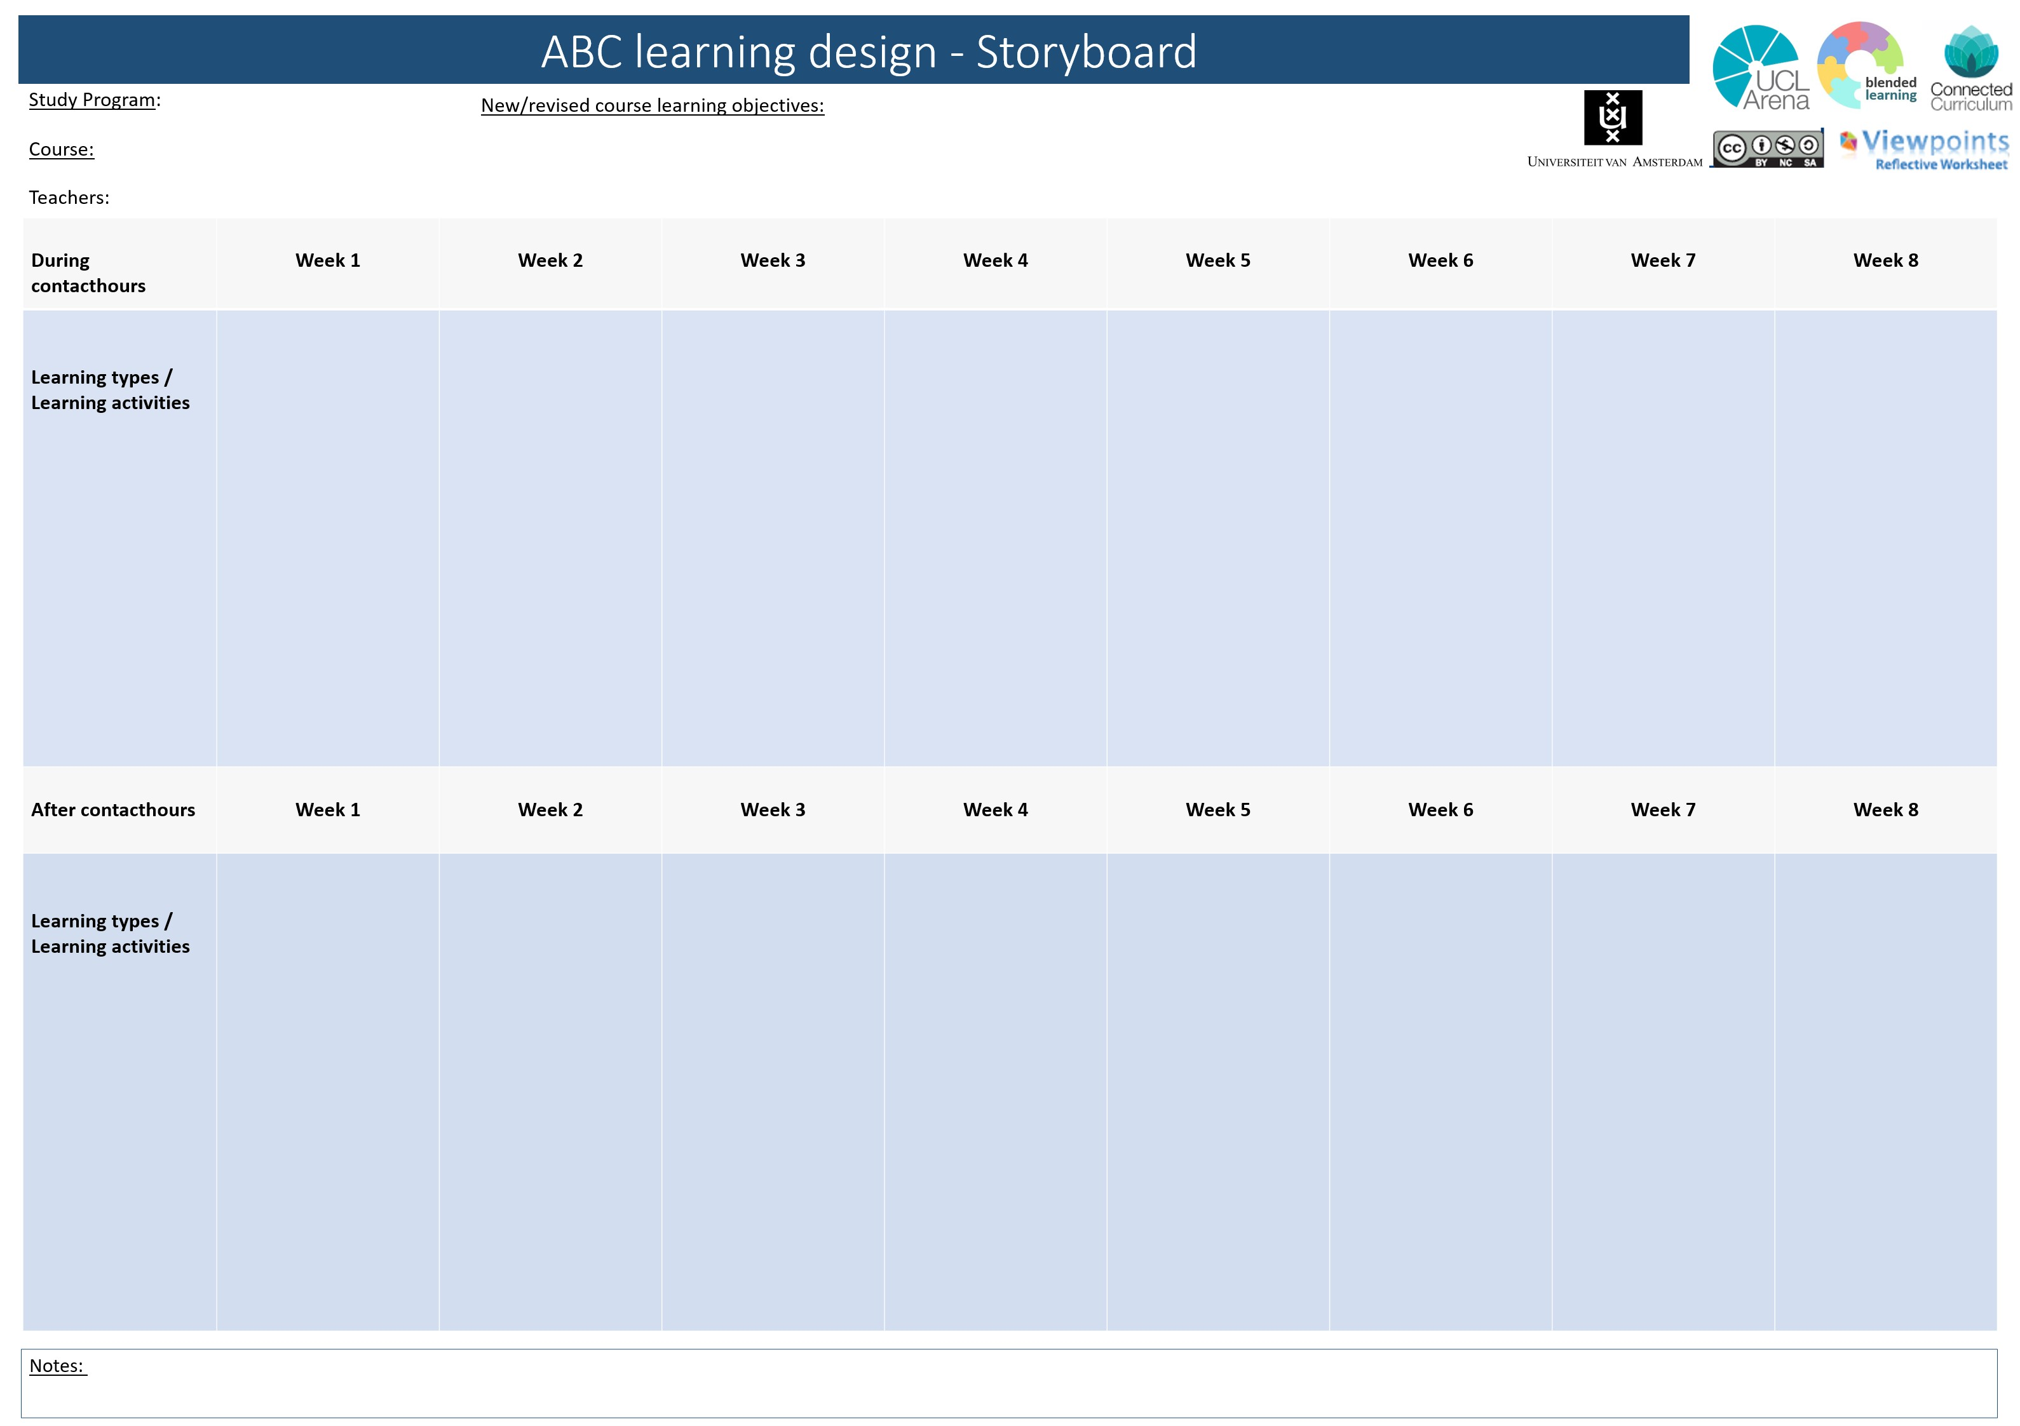
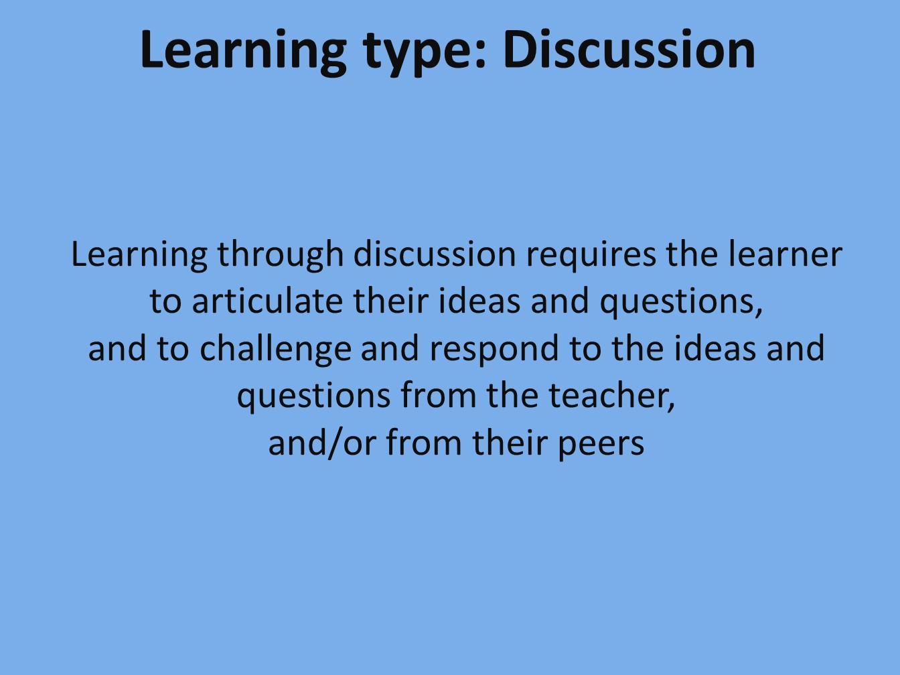
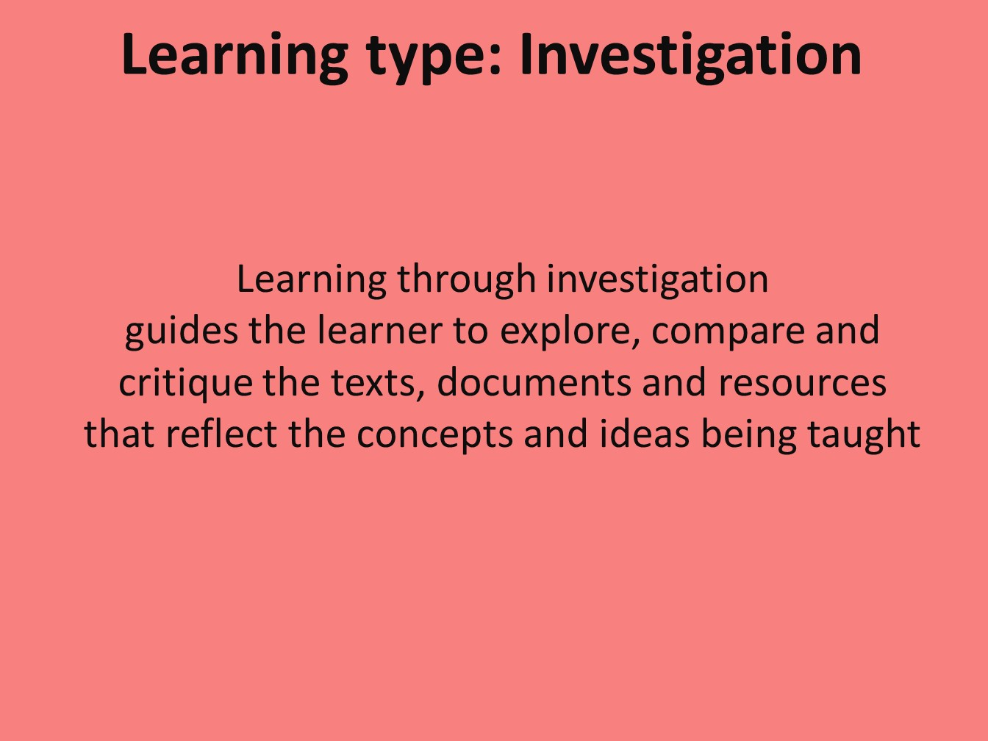
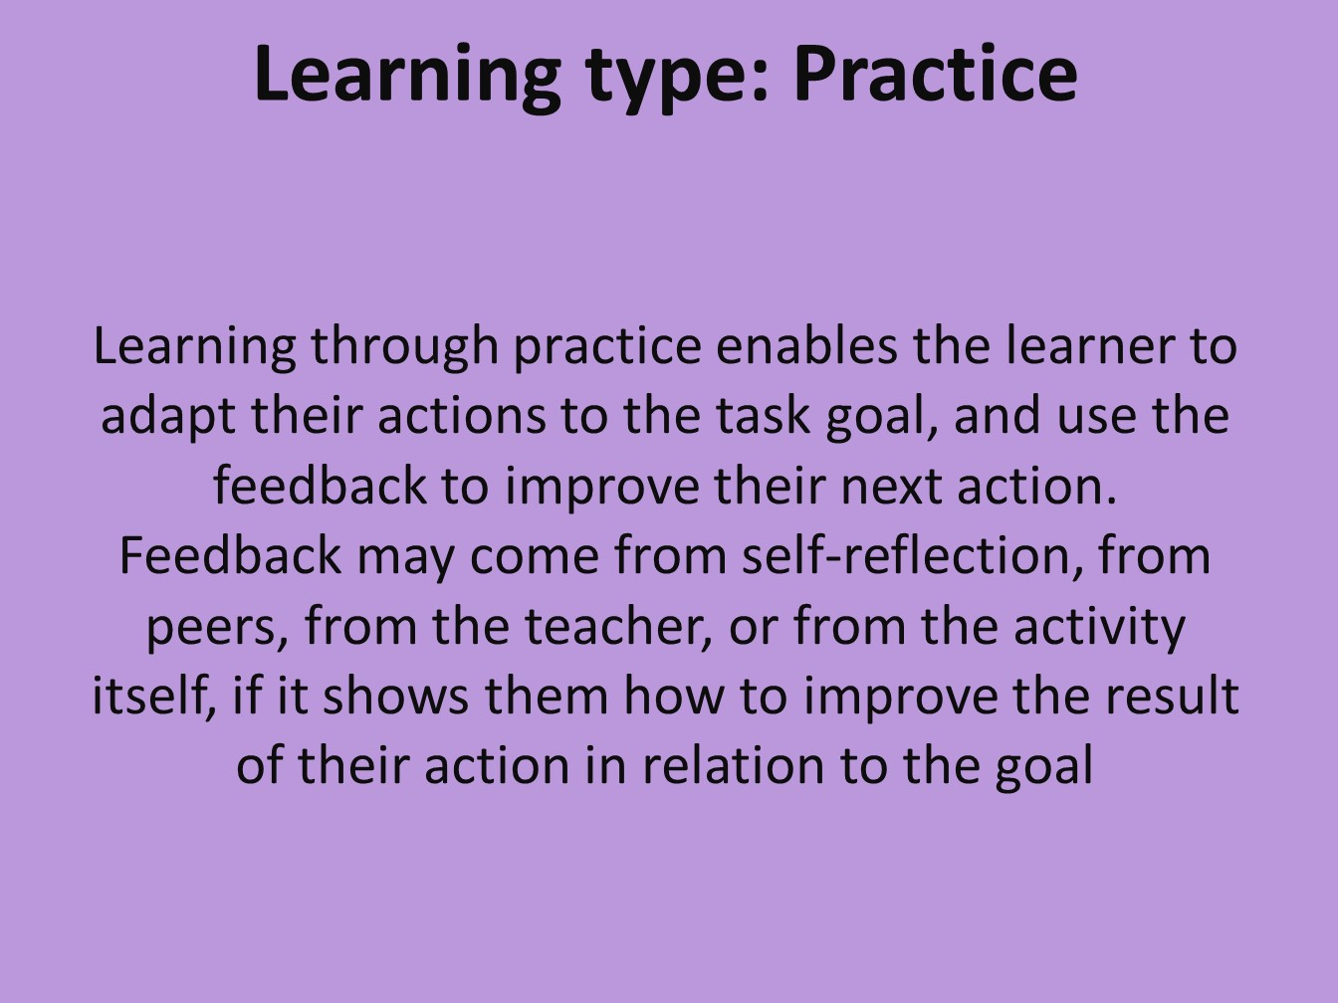
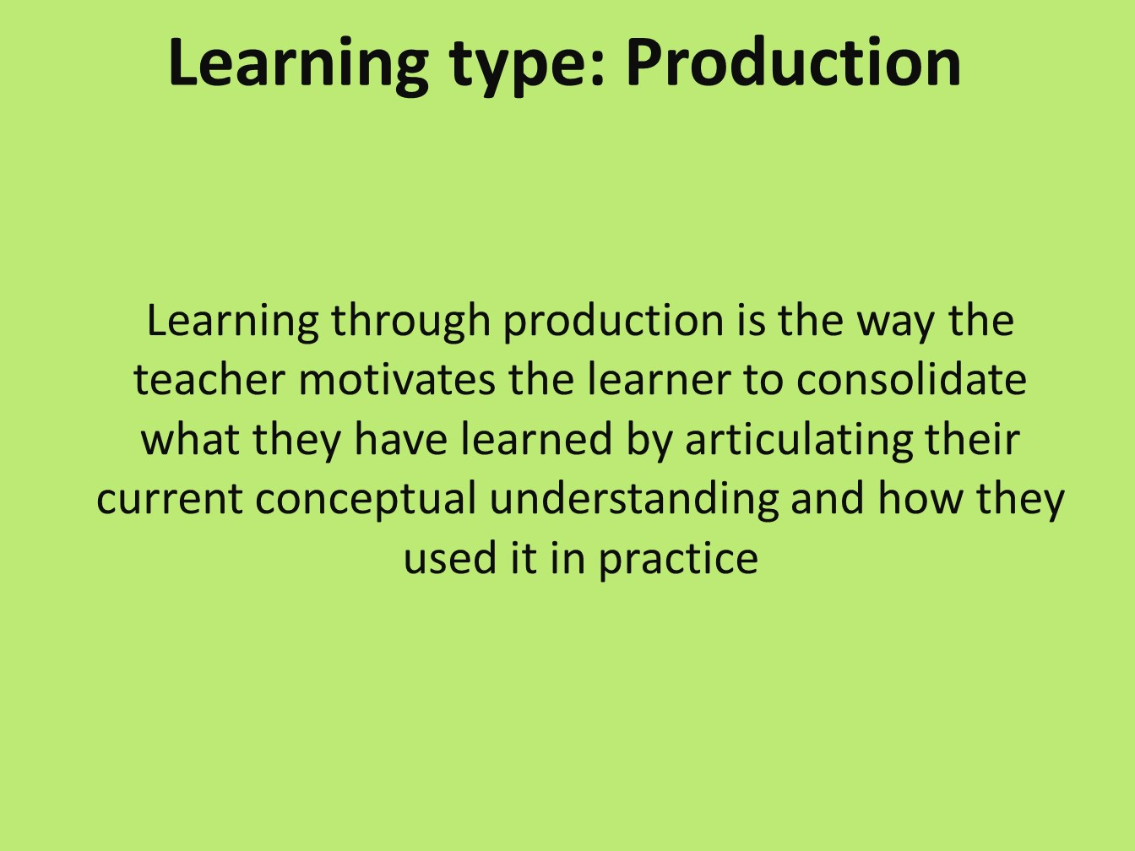
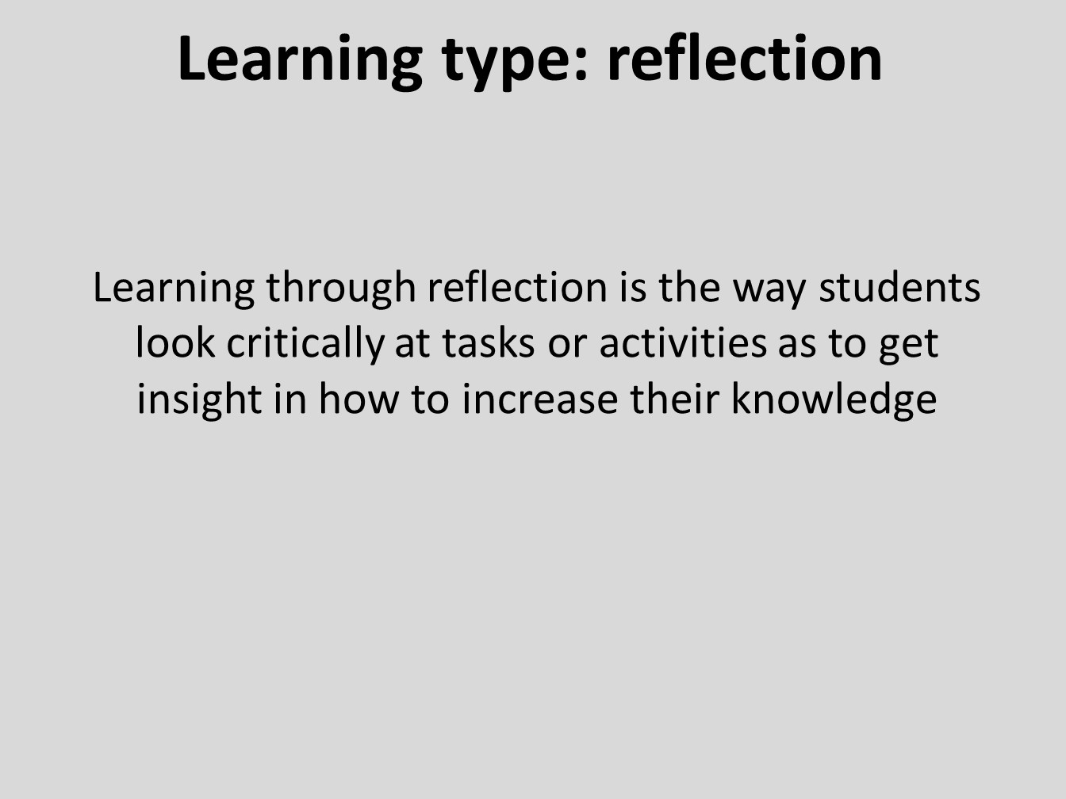
Notes:

Slide 8
Digital storyboard: types of learning activities
Use the cards to read about the different types of learning activities.
Drag a card from the stack to the corresponding week number, and place it ‘inside’ or ‘outside’ the contact hours.
  Use the same colour patterns as for the learning activities
  Write the learning activity on the card using a text box: insert > text box
  Sometimes a card needs to be brought to the foreground: right-click > bring to the front / foreground
  Not enough cards? Copy and paste the card(s).
Review the types of learning activities and indicate which will be assessed
  (A circle indicates summative assessment, a star formative assessment)
  A summative assessment is for a grade. A formative assessment is not graded but assesses an ongoing learning process.
  Read more about formative assessment (in Dutch).

Slide 9
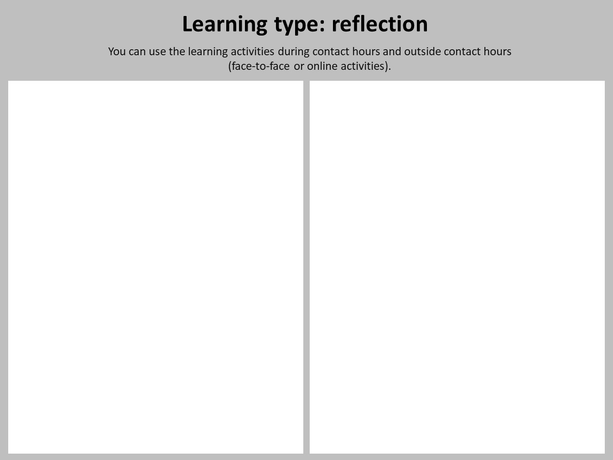
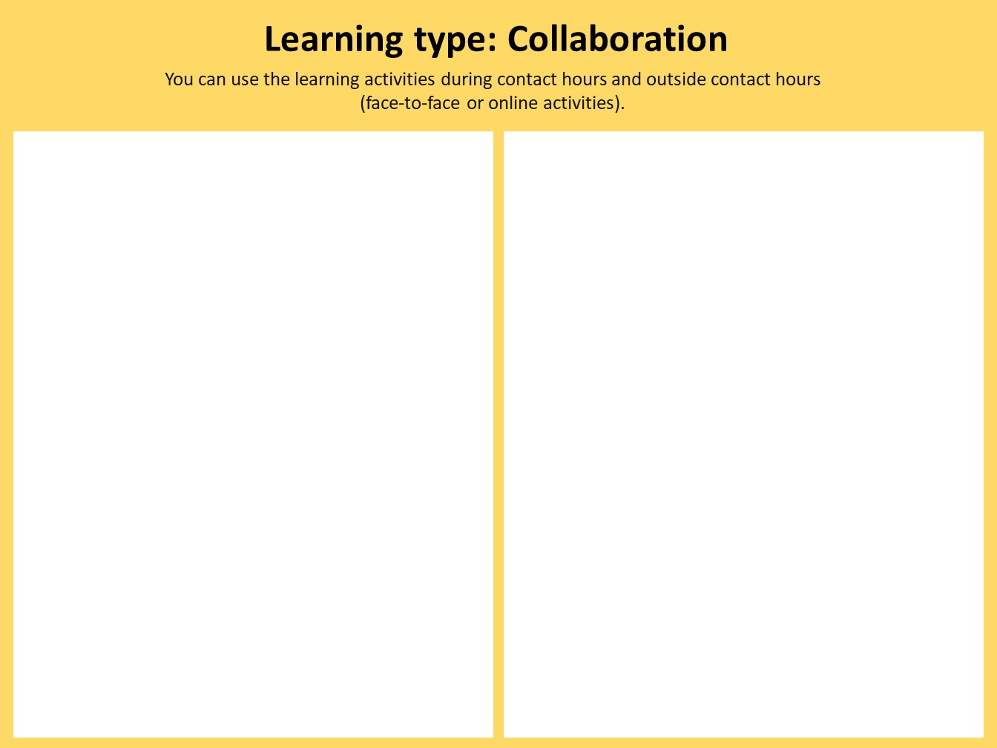
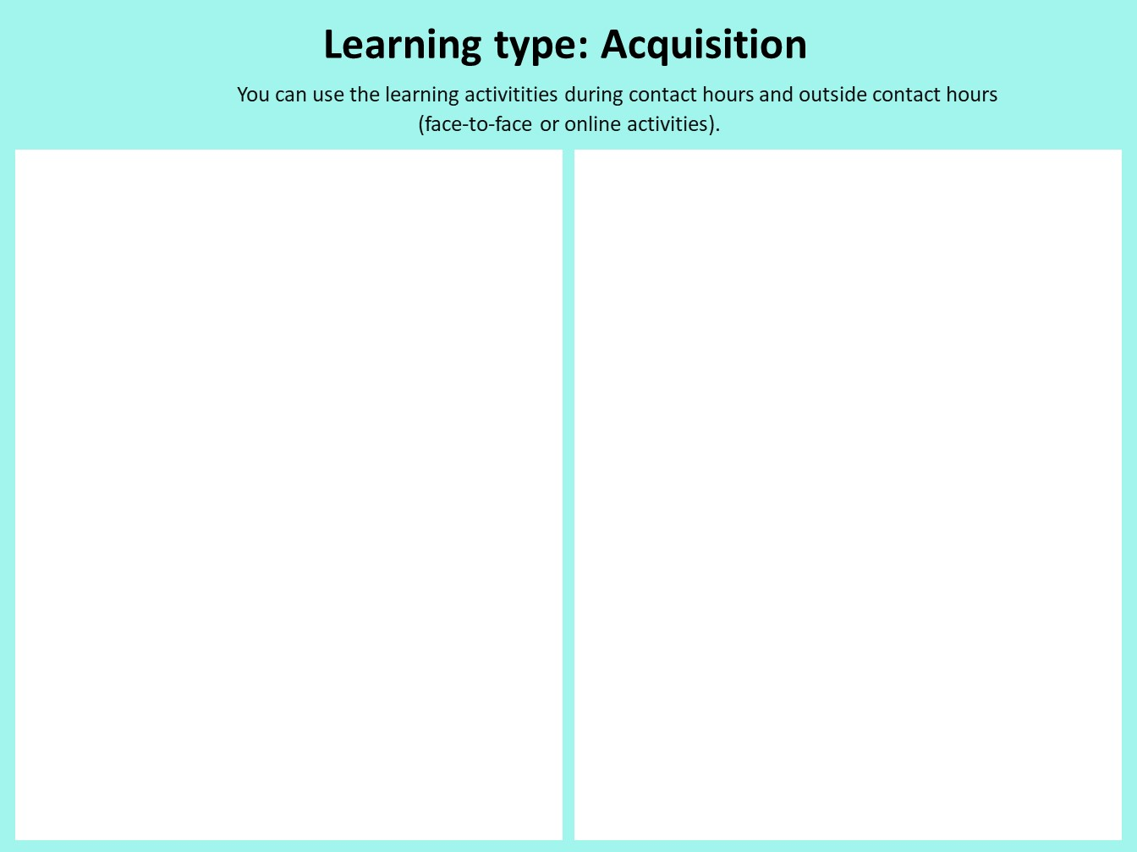
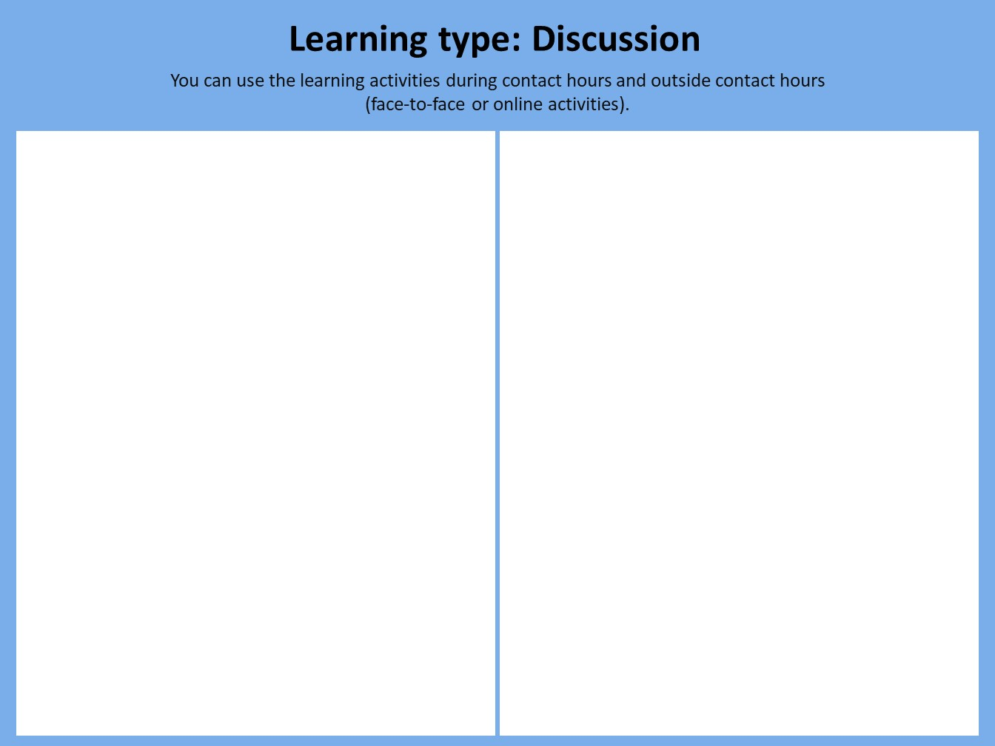
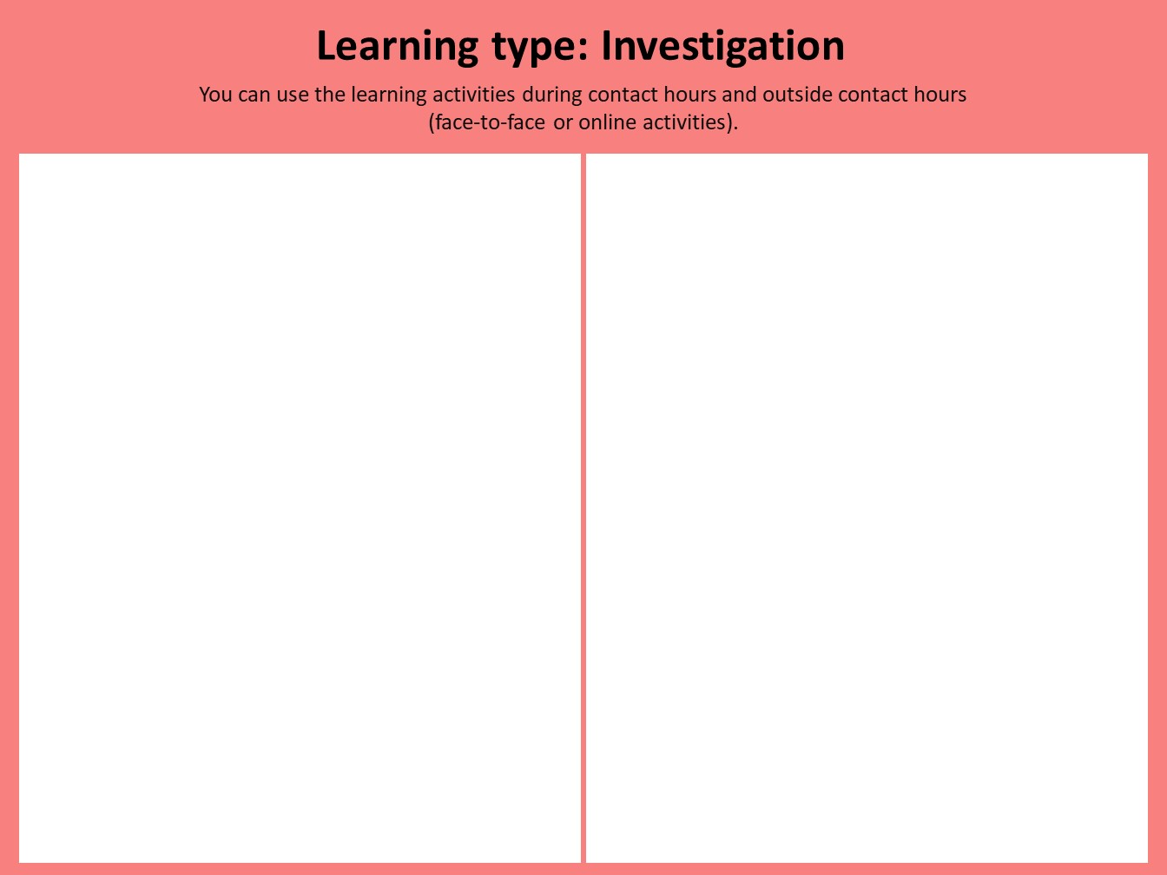
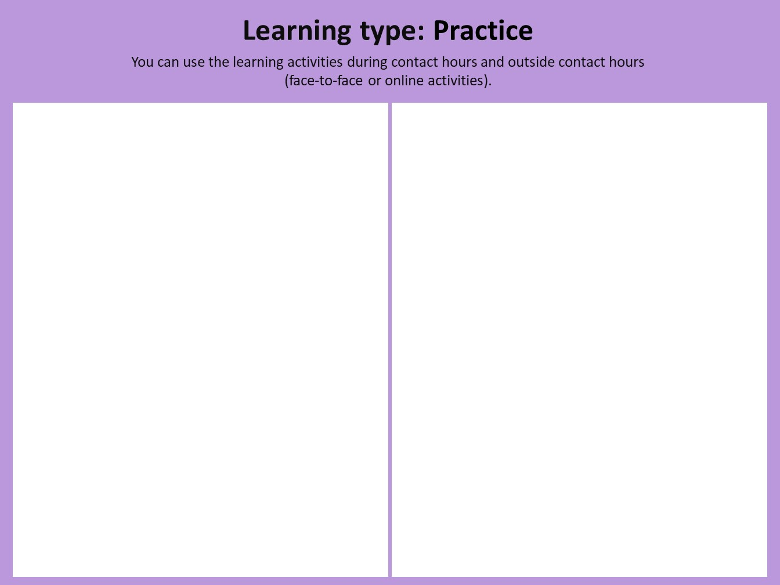
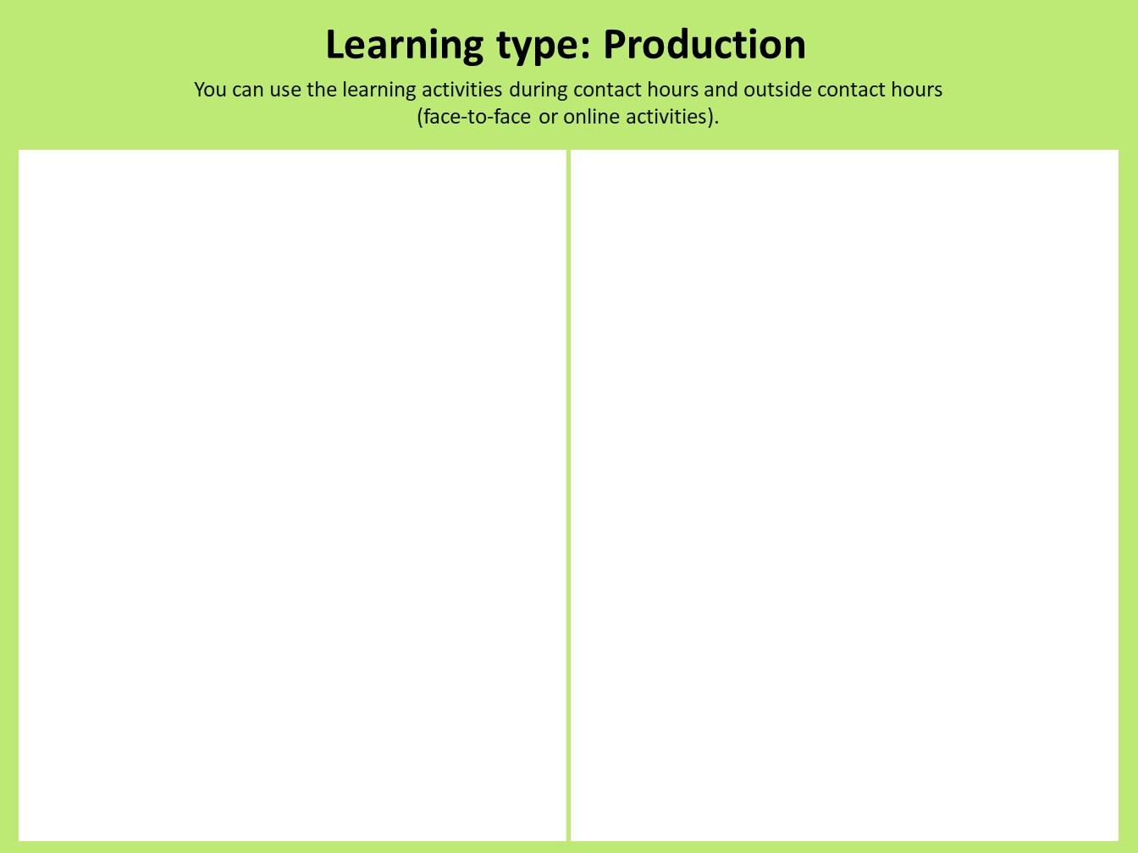


Formative
Notes:
Summative

Slide 10
Digital storyboard: action plan
Make an action plan:
  Who/ what do you need to take your design to the next step?
  Who/ what do you need to get more information to start using certain tools?
  Which colleagues would you still like to or need to consult with?
Go to the next slide and answer the questions
Go to the start sheet and fill in the web again.
  Use the red stars to show how your newly (re)designed course looks.

Slide 11

Arena blended Connected (ABC) Learning Design workshop action plan
Action plan | Who/where/when?
How can the Teaching and Learning Centre help you – what would you need from them?
What do you need from your course coordinator/ team?
What other input do you need?
Other notes….
This work is licensed under a creative commons Attribution-NonCommercial-ShareAlike 4.0 International (CC BY-NC-SA 4.0)
Notes:
Who/what do you need to develop your design further?
Who/what do you need to get more information on the use of certain tools?
Is consultation with colleagues and/or a subject coordinator required?

