Slide 1
Lunch session
Aspects of
Group Grading

Slide 2
Aspects of Group Grading
Introduction:
Who am I?
What’s the topic about?
Part 1:
The rules regarding group grading.
Conclusion – what is possible considering the rules?
Part 2:
How to grade a group? – quality criteria.
How to grade a group? – what to consider first.
Different ways how to evaluate and grade work process and progress and student’s attitude

Slide 3
Aspects of Group Grading
Introduction: who am I?
Since november 2022 I work as expert for educational assessment (toetsdeskundige) at the ESC of the FEB (team EQ&A).
The last six years I worked at universities in Germany and where I (among other things) developed and took care of (entry) assessments for different studies.
Prior to that I worked as assessment expert and project manager at Cito and as teacher and lecturer.

Slide 4
Aspects of Group Grading
Introduction: what’s the topic about?
Group grading:
Working in groups is very useful for students – key words are: social learning, creating professional working contexts, solving complex problems and so on…
BUT: What if group work need to be graded?

Slide 5
Aspects of Group Grading
Part 1: the rules regarding group grading
What the examination board says (and the examination).

Slide 6
Aspects of Group Grading
Part 1: the rules regarding group grading
Some principles must be followed:
The study guide is crucial: if you want to use group work or participation at any activity to give grades, or if you want the students to grade each other concerning to their group work, it has to be announced explicitly in the study guide.
In case the final grade is based less than 60% on individual work, it has to be in accordance to the examination regulation.

Slide 7
Aspects of Group Grading
Part 1: the rules regarding group grading
Some principles must be followed:
Every grade is always given by the examinator (lecturer). That means that grades given by student scan only be seen as a proposal. If students grade each other, the examinator still has got the right to differ from these grades.
The examinator also always has to be able to motivate the given grades. “It’s the grade given by your group you worked with” is not enough. Documentation of the work progress (can be provided by the students) is acceptable, but has to be as objective and based on facts as possible.
If a student disagrees, he first has to contact the examinator. If he/they can’t find a solution, the student has the possibility to contact the faculty board which shall activate the examination board. This whole procedure will only be on concern of the one student and not the group.

Slide 8
Aspects of Group Grading
Part 1: the rules regarding group grading
Some principles must be followed:
Grading only based on presence is not allowed; grading participation means that participation includes elements that can be graded valid, reliable and objective.

Slide 9
Aspects of Group Grading
Part 1: Conclusion – what is possible considering the rules?
Nearly every action in and outside the class can be graded if
- it is announced in the study guide,
- the examinator stays responsible for the grade,
- students are graded individually for at least 60%,
- grading follows the quality criteria.

Slide 10
Aspects of Group Grading
Questions so far?

Slide 11
Aspects of Group Grading
Part 2: how to grade a group? – quality criteria:
Grading group work must follow the same quality criteria as any other assessment:
- validity
- reliability
- objectivity
- transparency
- fairness

Slide 12
Aspects of Group Grading
Part 2: how to grade a group? – what to consider first:
Validity: how is the group work and the grading related to the learning outcomes?
→ group work can be graded best based on rubrics.
→ but: group work always includes teamwork ability as learning outcome. But how can you discriminate individual teamwork ability (even if you are not present)?

Slide 13
Aspects of Group Grading
Part 2: how to grade a group? – what to consider first:
Validity: how is the group work and the grading related to the learning outcomes?
→ group work can be graded best based on rubrics.
but: group work always includes teamwork ability as learning outcome. But how can you discriminate individual teamwork ability (even if you are not present)?
work process and progress, student’s attitude should be graded as well.

Slide 14
Aspects of Group Grading
Part 2: Different ways how to evaluate and grade work process and progress and student’s attitude:
observation: only possible in small classes and closed settings.
co-assessment: group work is graded not only by the examinator/lecturer but also by students (from other groups). But how can they grade groups they didn’t worked in?
peer-assessment: students within one group grade each other’s engagement during the work process.
self-assessment: students grade themselves resp. their own engagement during the work process.

Slide 15
Aspects of Group Grading
Part 2: How to be answerable regarding the grades based on co-, peer- and/or self-assessment:
ask students to write a logbook,
ask students to safe their online conversation (and hand it over),
let students work in digital workspaces and ask to record the (digital) meetings,
have an evaluation talk after the grading.

Slide 16
Aspects of Group Grading
Part 2: How to make sure that (co-,) peer- and/or self-assessment are as valid, reliable and objective as possible:
use rubrics (e.g. next sheet),
ask students to fill in the rubrics anonymous (actually there also reasons not to do so),
train students first so they all know what is meant by specific criteria’s in the rubric
→ remark: scores by self-assessment often are significant higher than scores by peer- or expert-assessment.
Following Kane and Lawler (1978) reliability of peer-assessment often is acceptable (between .48 and .89)

Slide 17
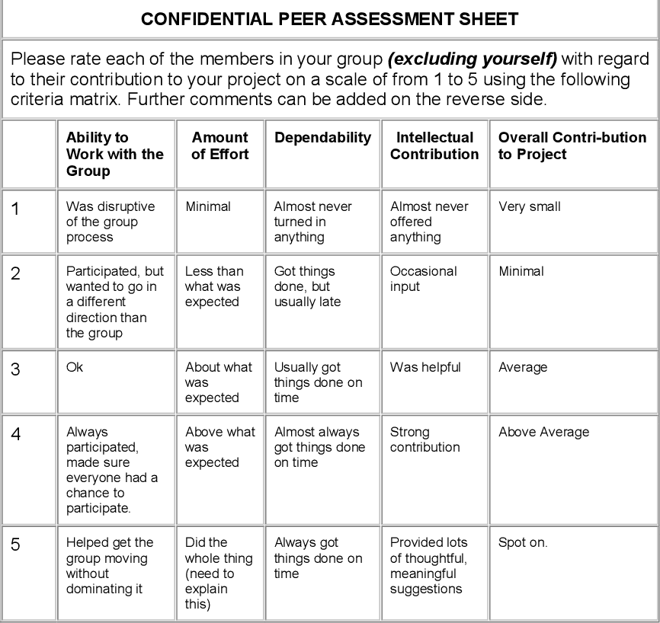
5=more than average engagement, 4=average engagement, 3=less than average engagement, 2=no engagement, 1=disturbing
Remark: you could also choose not to combine self- and peer-assessment
(Published in 2005: Peer assessment: A complementary instrument to recognise individual contributions in IS student group projects; E. Scott, N. V. D. Merwe, Derek C. Smith)

Slide 18
Questions?

